Slide 1
Verified programs and proofs in Dafny
K. Rustan M. Leino
Principal Researcher Research in Software Engineering (RiSE), Microsoft Research, Redmond
Visiting Professor Department of Computing, Imperial College London
7th Summer School on Formal Techniques, 22-26 May 2017, Atherton, CA

Slide 2
Software development is expensive and error prone
To verify software requires:
Specifications
Proofs
Tools
Expertise
Learning about specifications and proofs sharpens thinking

Slide 3
Some projects with verified software
Paris Metro line 14 brake system (B)
seL4 Verified (Haskell, Isabelle/HOL, C)
CompCert (Coq)
Ironclad, IronFleet (Dafny)
…
Common among these projects:
Tool is part of development process
Specifications, code, proofs developed together
No legacy code

Slide 4
Software verification systems
Verification done by formal-method experts
Paris Metro line 14 brake system (B)
seL4 Verified (Haskell, Isabelle/HOL, C)
CompCert (Coq)
Verification done by systems programmers
Ironclad, IronFleet (Dafny)

Slide 5

Dafny
Programming language designed for reasoning
Language features drawn from:
Imperative programming
if, while, :=, class, …
Functional programming
function, datatype, codatatype, …
Proof authoring
lemma, calc, refines, inductive predicate, …
Program verifier
Integrated development environment (IDE)

Slide 6
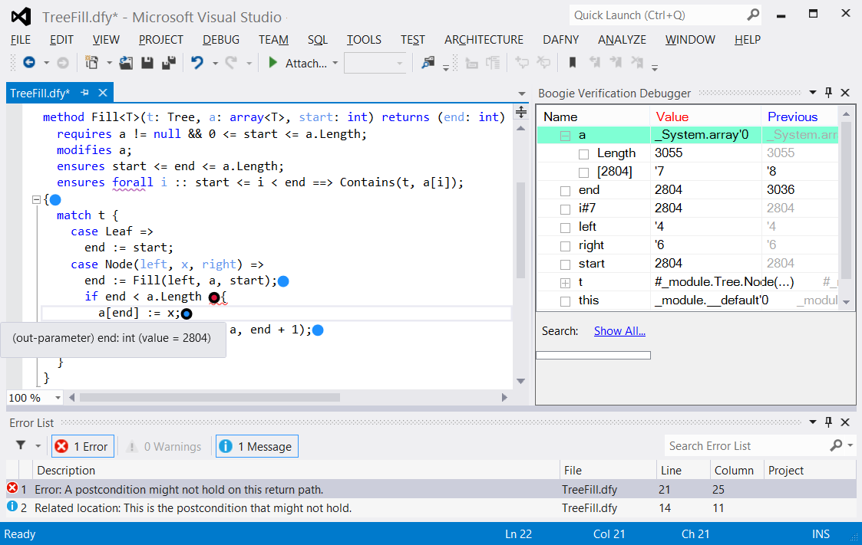
Using Dafny
Dafny IDE in Visual Studio
Dafny mode in Emacs
Dafny IDE in VS Code
In web browser at http://rise4fun.com/dafny
http://github.com/Microsoft/Dafny

Slide 7
Methods, pre- and postconditions

Slide 8
Hello world
method Main()
{
print "hello, Dafny\n";
}

Slide 9
Methods and calls
method Triple(x: int) returns (r: int)
ensures r >= 3*x
{
var y := Double(x);
r := y + x;
}
method Double(x: int) returns (r: int)
ensures r == 2*x
{
r := x + x;
}

Slide 10
Precondition
method MaxSum(x: int, y: int) returns (m: int, s: int)
ensures s == x + y
ensures m >= x && m >= y
ensures m == x || m == y
{
s := x + y;
m := if x < y then y else x;
}
method MaxSumBackwards(m: int, s: int) returns (x: int, y: int)
requires 2*m >= s
ensures s == x + y
ensures m >= x && m >= y
ensures m == x || m == y
{
x, y := m, s - m;
}

Slide 11
Loop invariants, quantifiers

Slide 12
Loop invariants
method CountToN(n: int)
requires 0 <= n
{
var i := 0;
while i < n
invariant i <= n
{
i := i + 1;
}
assert i == n;
}

Slide 13
Computing Fib iteratively
method ComputeFib(n: nat) returns (x: nat)
ensures x == Fib(n)
{
x := 0;
var i, y := 0, 1;
while i < n
invariant i <= n
invariant x == Fib(i) && y == Fib(i+1)
{
x, y := y, x+y;
i := i + 1;
}
}

Slide 14
Heuristics for inventing invariants
method Min(a: array<int>) returns (m: int)
requires a != null && a.Length != 0
ensures forall i :: 0 <= i < a.Length ==> m <= a[i]
ensures exists i :: 0 <= i < a.Length && m == a[i]
{
var n := 0;
m := a[0];
while n < a.Length
invariant n <= a.Length
invariant forall i :: 0 <= i < n ==> m <= a[i]
invariant exists i :: 0 <= i < a.Length && m == a[i]
{
if a[n] < m {
m := a[n];
}
n := n + 1;
}
}
Replace a constant by a variable
Maintain always

Slide 15
Binary search

Slide 16
method BinarySearch(a: array<int>, key: int) returns (r: int)
requires a != null
requires forall i,j :: 0 <= i < j < a.Length ==> a[i] <= a[j]
ensures 0 <= r ==> r < a.Length && a[r] == key
ensures r < 0 ==> forall i :: 0 <= i < a.Length ==> a[i] != key
{
var lo, hi := 0, a.Length;
while lo < hi
invariant 0 <= lo <= hi <= a.Length
invariant forall i :: 0 <= i < lo ==> a[i] != key
invariant forall i :: hi <= i < a.Length ==> a[i] != key
{
var mid := (lo + hi) / 2;
if key < a[mid] {
hi := mid;
} else if a[mid] < key {
lo := mid + 1;
} else {
return mid;
}
}
return -1;
}

Slide 17
newtype int32 = x | -0x8000_0000 <= x < 0x8000_0000
method BinarySearch'(a: array<int>, key: int) returns (r: int32)
requires a != null && a.Length < 0x8000_0000
requires forall i,j :: 0 <= i < j < a.Length ==> a[i] <= a[j]
ensures 0 <= r ==> r < a.Length as int32 && a[r] == key
ensures r < 0 ==> forall i :: 0 <= i < a.Length ==> a[i] != key
{
var lo, hi := 0, a.Length as int32;
while lo < hi
invariant 0 <= lo <= hi <= a.Length as int32
invariant forall i :: 0 <= i < lo ==> a[i] != key
invariant forall i :: hi <= i < a.Length as int32 ==> a[i] != key
{
// var mid := (lo + hi) / 2; // error: overflow
var mid := lo + (hi - lo) / 2;
assert mid as int == (lo as int + hi as int) / 2;
if key < a[mid] {
hi := mid;
} else if a[mid] < key {
lo := mid + 1;
} else {
return mid;
}
}
return -1;
}

Slide 18
Sorting

Slide 19

Dutch Flag
0
r
w
b
a.Length
Photo credit: http://static.guim.co.uk/sys-images/Guardian/Pix/pictures/2013/5/8/1368026309503/dutch-flag-010.jpg

Slide 20
datatype Color = Red | White | Blue
predicate Below(c: Color, d: Color)
{
c == Red || c == d || d == Blue
}

Slide 21
method DutchFlag(a: array<Color>)
requires a != null
modifies a
ensures forall i,j :: 0 <= i < j < a.Length ==> Below(a[i], a[j])
ensures multiset(a[..]) == old(multiset(a[..]))
{
var r, w, b := 0, 0, a.Length;
while w < b
invariant 0 <= r <= w <= b <= a.Length
invariant forall i :: 0 <= i < r ==> a[i] == Red
invariant forall i :: r <= i < w ==> a[i] == White
invariant forall i :: b <= i < a.Length ==> a[i] == Blue
invariant multiset(a[..]) == old(multiset(a[..]))
{
match a[w]
case Red =>
a[r], a[w] := a[w], a[r];
r, w := r + 1, w + 1;
case White =>
w := w + 1;
case Blue =>
a[w], a[b-1] := a[b-1], a[w];
b := b - 1;
}
}

Slide 22
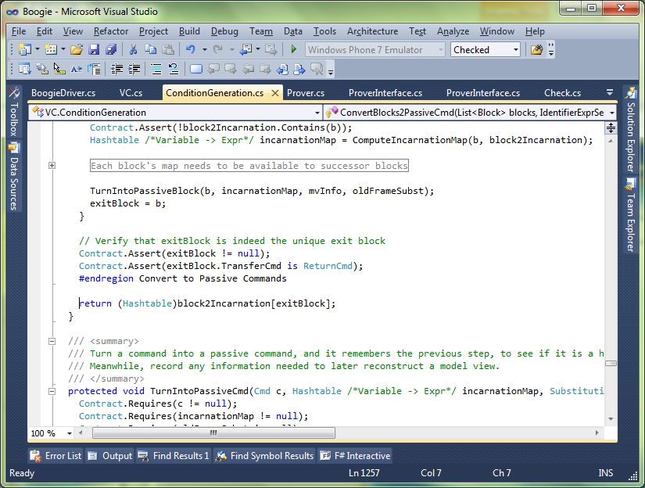
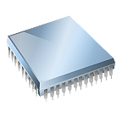
Separation of concerns
Dafny
Dafny
Intermediate representation
Intermediate verification language
Compiler
Verifier
SMT solver

Slide 23
Verification architecture
Dafny
Boogie
SMT solver

Slide 24
Meet the family
GPU Verify
STORM (C)
Boogie x86
…
Corral
QED
C B Analyze
Poirot
Forró
Diego-matic
Spec#
VCC (C)
HAVOC (C)
Dafny
Chalice
Eiffel (EveProofs)
Java BML
Region Logic
Boogie
Boogie Verification Debugger
inference
SymDiff
SMT Lib
Z3

Slide 25
Verification architecture
Frama-C
Hi-Lite Ada
Pangoline
Who
Jessie
Krakatoa
CAO
Why3
Alt-Ergo
…
SMT Lib
Z3
Coq
Isabelle/HOL
CVC 3

Slide 26
Functions, lemmas

Slide 27
Datatypes
datatype Tree<T> = Leaf | Node(Tree<T>, T, Tree<T>)
function Mirror(t: Tree): Tree
{
match t
case Leaf => Leaf
case Node(l, x, r) => Node(Mirror(r), x, Mirror(l))
}

Slide 28
A lemma about Mirror
lemma MirrorMirror(t: Tree)
ensures Mirror(Mirror(t)) == t
{
match t
case Leaf =>
case Node(l, x, r) =>
calc {
Mirror(Mirror(t));
== // what t is
Mirror(Mirror(Node(l, x, r)));
== // def. Mirror
Mirror(Node(Mirror(r), x, Mirror(l)));
== // def. Mirror
Node(Mirror(Mirror(l)), x, Mirror(Mirror(r)));
== { MirrorMirror(l); MirrorMirror(r); }
Node(l, x, r);
== // what t is
t;
}
}

Slide 29
An alternative proof (advanced)
lemma MirrorMirror<T>(t: Tree)
ensures Mirror(Mirror(t)) == t
{
forall t': Tree<T> | t' < t {
MirrorMirror(t');
}
}

Slide 30
Universal introduction (advanced)
lemma AllMirrorMirror<T>()
ensures forall t: Tree<T> :: Mirror(Mirror(t)) == t
{
forall t: Tree<T>
ensures Mirror(Mirror(t)) == t
{
MirrorMirror(t);
}
}

Slide 31
Lab exercises to practice writing proofs
Properties of Fibonacci
http://rise4fun.com/Dafny/jlbP
Prove that F and G return the same results
http://rise4fun.com/Dafny/0wN3
Properties of Add
http://rise4fun.com/Dafny/f7Ql
Multiplication by repeated addition is commutative
http://rise4fun.com/Dafny/9HWl
Array elements (a lemma that is useful to the CoincidenceCount program)
http://rise4fun.com/Dafny/BeuY

Slide 32
A property about Fib
lemma FibProperty0(n: nat)
requires 1 <= n
ensures 1 <= Fib(n)
{
if n < 3 {
assert Fib(n) == 1;
} else {
calc {
Fib(n);
== // def. Fib
Fib(n-2) + Fib(n-1);
>= { FibProperty0(n-2); }
1 + Fib(n-1);
>= { FibProperty0(n-1); }
1 + 1;
>= // arithmetic
1;
}
}
}

Slide 33
Another property of Fib
lemma FibProperty1(n: nat)
requires 5 <= n
ensures n <= Fib(n)
{
if n == 5 {
assert Fib(5) == 5;
} else if n == 6{
assert Fib(6) == 8;
} else {
calc {
Fib(n);
== // def. Fib
Fib(n-2) + Fib(n-1);
>= { FibProperty1(n-2); }
n-2 + Fib(n-1);
>= { FibProperty1(n-1); }
n-2 + n-1;
>= { assert 7 <= n; }
7-2 + n-1;
== // arithmetic
n + 4;
>= // arithmetic
n;
}
}
}

Slide 34
An alternative proof
lemma FibProperty1(n: int)
requires 5 <= n
ensures n <= Fib(n)
{
if n < 7 {
} else {
FibProperty1(n-2);
FibProperty1(n-1);
}
}

Slide 35
Two ways of iterating a function
// An opaque type
type T
// A function without a body is an uninterpreted function
function f(x: T): T
// Functions F(x,n) and G(x,n) apply f to x n times. That is, they return f^n(x).
function F(x: T, n: nat): T
{
if n == 0 then x else F(f(x), n-1)
}
function G(x: T, n: nat): T
{
if n == 0 then x else f(G(x, n-1))
}

Slide 36
lemma FGSame(x: T, n: nat)
ensures F(x, n) == G(x, n)
{
if 2 <= n {
calc {
F(x, n);
== // def. F
F(f(x), n-1);
== { FGSame(f(x), n-1); }
G(f(x), n-1);
== // def. G
f(G(f(x), n-2));
== { FGSame(f(x), n-2); }
f(F(f(x), n-2));
== // def. F
f(F(x, n-1));
== { FGSame(x, n-1); }
f(G(x, n-1));
== // def. G
G(x, n);
}
}
}

Slide 37
Multiplication by repeated addition
function Mult(x: nat, y: nat): nat
{
if y == 0 then 0 else x + Mult(x, y-1)
}
lemma MultCorrect(x: nat, y: nat)
ensures Mult(x, y) == x*y
{
if y == 0 {
} else {
calc {
Mult(x, y);
== // def. Mult
x + Mult(x, y-1);
== { MultCorrect(x, y-1); }
x + x * (y-1);
== // arithmetic
x*1 + x*(y-1);
== // distribute * and +
x*(1 + y-1);
== // arithmetic
x * y;
}
}
}

Slide 38
Mult is commutative
lemma MultCommutative(x: nat, y: nat)
ensures Mult(x, y) == Mult(y, x)
{
if x == y {
} else if y < x {
MultCommutative(y, x); // Mult(y, x) == Mult(x, y)
} else if x == 0 {
MultCommutative(x, y-1);
} else {
assert x != y && x <= y && x != 0 && y != 0;
calc {
Mult(x, y);
== // def. Mult
x + Mult(x, y-1);
== { MultCommutative(x, y-1); }
x + Mult(y-1, x);
== // def. Mult
x + y - 1 + Mult(y-1, x-1);
== { MultCommutative(x-1, y-1); }
x + y - 1 + Mult(x-1, y-1);
== // def. Mult
y + Mult(x-1, y);
== { MultCommutative(x-1, y); }
y + Mult(y, x-1);
== // def. Mult
Mult(y, x);
}
}
}

Slide 39
Putting it all together: Coincidence count
method CC(a: array<int>, b: array<int>) returns (c: int)
requires a != null && b != null && Inc(a) && Inc(b)
ensures c == |E(a,0) * E(b,0)|
// …
predicate Inc(a: array<int>)
requires a != null
reads a
{
forall i,j :: 0 <= i < j < a.Length ==> a[i] < a[j]
}
function E(a: array<int>, start: nat): set<int>
requires a != null && start <= a.Length
reads a
decreases a.Length - start
{
if start == a.Length then {} else {a[start]} + E(a, start+1)
}

Slide 40
lemma Lemma(a: array<int>, start: nat, x: int)
requires a != null && start <= a.Length
requires x !in a[start..]
ensures x !in E(a, start)
decreases a.Length - start
{
}

Slide 41
method CC(a: array<int>, b: array<int>) returns (c: int)
requires a != null && b != null && Inc(a) && Inc(b)
ensures c == |E(a,0) * E(b,0)|
{
var i, j := 0, 0;
c := 0;
while i < a.Length && j < b.Length
invariant i <= a.Length && j <= b.Length
invariant |E(a,0) * E(b,0)| == c + |E(a,i) * E(b,j)|
decreases a.Length + b.Length - i - j
{
if a[i] < b[j] {
calc {
E(a,i) * E(b,j);
==
({a[i]} + E(a,i+1)) * E(b,j);
==
({a[i]} * E(b,j)) + (E(a,i+1) * E(b,j));
== { Lemma(b, j, a[i]); }
E(a,i+1) * E(b,j);
}
i := i + 1;
} else if b[j] < a[i] {
calc {
E(a,i) * E(b,j);
== { Lemma(a, i, b[j]); }
E(a,i) * E(b,j+1);
}
j := j + 1;
} else {
ghost var x, A, B := a[i], E(a,i+1), E(b,j+1);
ghost var X := {x};
calc {
E(a,i) * E(b,j);
==
(X + A) * (X + B);
==
(X * X) + (X * B) + (A * X) + (A * B);
== { Lemma(a, i+1, x); Lemma(b, j+1, x); }
X + (A * B);
}
calc {
|X + (A * B)|;
== { Lemma(a, i+1, x); }
|X| + |A * B|;
}
c, i, j := c+1, i+1, j+1;
}
}
}

Slide 42
Conclusions
Pre- and postconditions
Contract between callers and implementations
Precondition
must be established by callers
can be assumed on entry to the implementation
Postcondition
must be established by implementation
can be assume upon return from calls
Invariants
Something that “always” holds
Must be established initially and must be maintained
Can be assumed at stable points
Induction
Recursive call to a lemma
Make sure it terminates!
Dafny can be used
to write verified programs
to formalize and write proofs
in teaching
Learn more
See list at https://github.com/Microsoft/dafny/
Tutorial at http://rise4fun.com/dafny
Verification Corner channel on youtube

