Slide 1
Industrial experience with a verification-aware programming language
K. Rustan M. Leino (he/him) Sr Principal Applied Scientist
Amazon Web Services
iFM 2023 Leiden, NL 14 Nov 2023

Slide 2
My talk
Reflect on
Lessons learned from working with engineers to verify software
How this experience has influenced the language and its tooling

Slide 3
Automated Reasoning at AWS
Use of sound logical tools and techniques to prove properties of software
To have lasting impact, the tools must be applied with every code check-in
To scale, the tools must be used by people outside the Automated Reasoning Group

Slide 4
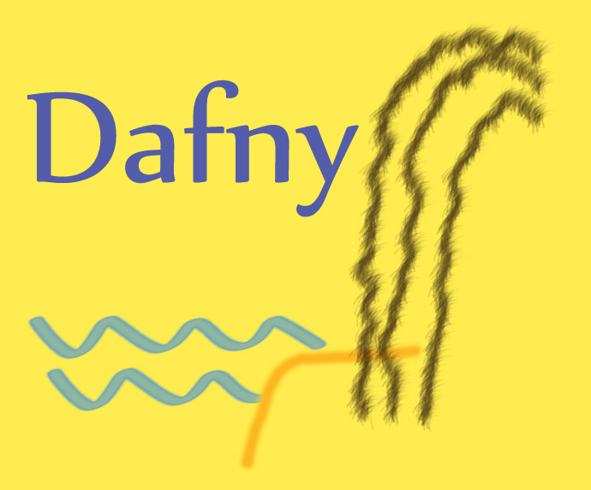
Dafny
Verification-aware programming language
Java-like language
Designed to support formal verification
Coming up on 16 years
Open source

Slide 5
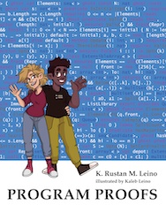
Dafny for every engineer
Is a programming language
Specifications are part of the language Not a bolt-on to non-verification language
Targets programmers Not type-theorists or logicians Uses curly braces
Used in teaching for 15+ years New book: Program Proofs (MIT Press)
Auto-active verification (interactive + automated) Centers on programs Proofs are part of the program text

Slide 6
Demo
FindLast

Slide 7
Public uses of Dafny at AWS
AWS Encryption SDK
AWS Database Encryption SDK
Cedar authorization policy engine

Slide 8
Dafny leverage points
Write verified code
Write and verify once, compile to many
Abstract modeling

Slide 9
Dafny design: program expressions, specification expressions
They are the same
Same syntax
Same semantics
Demo…
method FindLast<X>(arr: array<X>, x: X) returns (result: int)
requires exists i :: 0 <= i < arr.Length && arr[i] == x
var b := exists i :: 0 <= i < arr.Length && arr[i] == x;

Slide 10
Dafny design: program expressions, specification expressions
They are the same
Same syntax
Same semantics
Not all expressions are evaluated at run time Ghost declarations Specifications are always checked statically
var d := x + y + 1;
ghost var g := d + x;
ghost function IsBalanced(t: Tree): bool

Slide 11
Dafny design: expressions vs statements
Expressions deterministic do not modify the program state terminate
Functions body is expression behave like in mathematics
Statements can be nondeterministic can modify the state can be specified to allow non-termination
Methods body is statement list
function Increase(x: nat): nat {
var d := x + x;
d + 1
}
method Increase(x: nat) returns (r: nat) {
var d := x + x;
return d + 1;
}

Slide 12
Dafny design: importance that keywords convey right meaning
Example: Want statement that is checked at run time (like assume E; in some languages) assumed by verifier to hold (like assume E;)
expect E;

Slide 13
Keywords for Compiled vs. Ghost
 | Compiled | Ghost
Variable | var
Function | function
Method | method

Slide 14
Keywords for Compiled vs. Ghost
 | Compiled | Ghost
Variable | var | ghost var
Function | function
Method | method

Slide 15
Keywords for Compiled vs. Ghost
 | Compiled | Ghost
Variable | var | ghost var
Function | function | ghost function
Method | method

Slide 16
Keywords for Compiled vs. Ghost
 | Compiled | Ghost
Variable | var | ghost var
Function | function | ghost function
Method | method | ghost method

Slide 17
Keywords for Compiled vs. Ghost
 | Compiled | Ghost
Variable | var | ghost var
Function | function | ghost function
Method | method | ghost method lemma

Slide 18
Keywords for Compiled vs. Ghost
 | Compiled | Ghost
Variable | var | ghost var
Function | function method function | function ghost function
Method | method | lemma

Slide 19
Developer expectations: Dafny ecosystem
Language
Compiler(s)
Verifier
Documentation, training
IDEs
Standard library
Build system
Testing tools
Foreign function interface
Linters
Verification debugger
…

Slide 20
Influence from customers
Unicode support
Handling failures
Failure-compatible types
Change of definite-assignment rules
stricter than required by sound verification
expected by programmers, and catches common errors

Slide 21
Simplify for customers: loop alternatives
Demo…

Slide 22
Simplify for customers: Auto-accumulator tail recursion
function Filter<T>(s: seq<T>, p: T -> bool): seq<T> {
if s == [] then
[]
else if p(s[0]) then
[s[0]] + Filter(s[1..], p)
else
Filter(s[1..], p)
}

Slide 23
Experience: Specifications
The process of writing specifications uncovers design bugs
Writing specifications is hard
Better specifications are usually more abstract

Slide 24
Demo
SplitString

Slide 25
Foreign-function interface (extern code)
Writing specifications for extern code is even harder
“Verification finds all bugs” can be misunderstood

Slide 26
Foreign-function interface: difficulty
method {:extern} Concat<X>(a: array<X>,
b: array<X>,
limit: int) returns (r: array<X>)
ensures r[..] == (a[..] + b[..])[..Max(0, Min(|a| + |b|, limit))]
ensures fresh(r)
But perhaps the extern method
expects limit to be non-negative
returns a or b if the other is empty
returns null in some cases

Slide 27
Foreign-function interface: difficulty
🚫
method {:extern “Logger.Append”} LogEvent(s: string)
ensures log.data == old(log.data) + [s]
method {:extern “Logger.Append”} LogEvent(s: string)
modifies log
ensures log.data == old(log.data) + [s]
✅

Slide 28
Foreign-function interface: difficulty
🚫
function {:extern “System.DateTime.Now”} GetTime(): Time
method {:extern “System.DateTime.Now”} GetTime() returns (t: Time)
✅

Slide 29
Foreign-function interface (extern code)
How to avoid errors in extern specifications?
auditor tool
expect statements
run-time specification checking
“bland externs”

Slide 30
Proofs
For programmers

Slide 31
Demo
Wildcard matching: declarative vs operational

Slide 32
Automation
Early days of Dafny: Automation always
Then: Added repertoire of proof-authoring constructs
Now: Favor stability over automation
Still need: Helpful tools for proof construction Helpful tools for verification debugging Educate more

Slide 33
Conclusions
Programming with specifications and proofs, in practice
Listen to customer complaints
Don’t be too defensive
Innovate on behalf of customers
Need more automated-reasoning savvy users
Teach!
dafny.org
program-proofs.com

