Slide 1
The life of a scientist: dream, build, learn, explain
K. Rustan M. Leino
PhD Symposium, iFM 2023 Leiden, NL 16 November 2023

Slide 2
The life of a scientist—and person
Scientific matters
Family
Friends
Extracurricular activities
Physical health
Emotional health
Spiritual health
Charity work
Activism
…

Slide 3
Outline
My background
On the PhD
On practicing
On impact
On collaboration
On writing
On organization
On being yourself

Slide 4
My engineering/scientific background
1989
1990
1992
1993
1994
1991
1995
1996
1997
1998
1999
2000
2001
2002
2003
2004
2005
2006
2007
2008
2009
2010
2011
2012
2013
2014
2015
2016
2017
2018
2019
2020
2021
2022
2023
Internships DEC SRC
Visiting professor Imperial College London
Microsoft Windows
Caltech
DEC SRC
Compaq SRC
Microsoft Research
Amazon Web Services
BA UT Austin
MS Caltech
PhD Caltech

Slide 5
… from a tool perspective
1989
1990
1992
1993
1994
1991
1995
1996
1997
1998
1999
2000
2001
2002
2003
2004
2005
2006
2007
2008
2009
2010
2011
2012
2013
2014
2015
2016
2017
2018
2019
2020
2021
2022
2023
Internship DEC SRC
Caltech
DEC SRC
Compaq SRC
Microsoft Research
Amazon Web Services
ESC Modula-3
ESC/Java
Boogie
Dafny
Houdini
Spec#
Chalice
Quivela
Ecstatic
Oolong
Forró

Slide 6
On the PhD
Purpose: training for doing scientific exploration and discovery
Imposter syndrome
The beginning, not the end

Slide 7
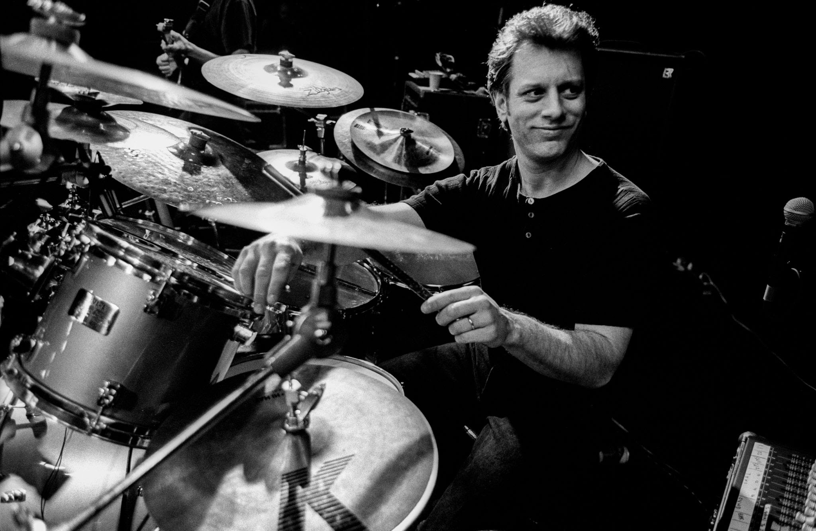
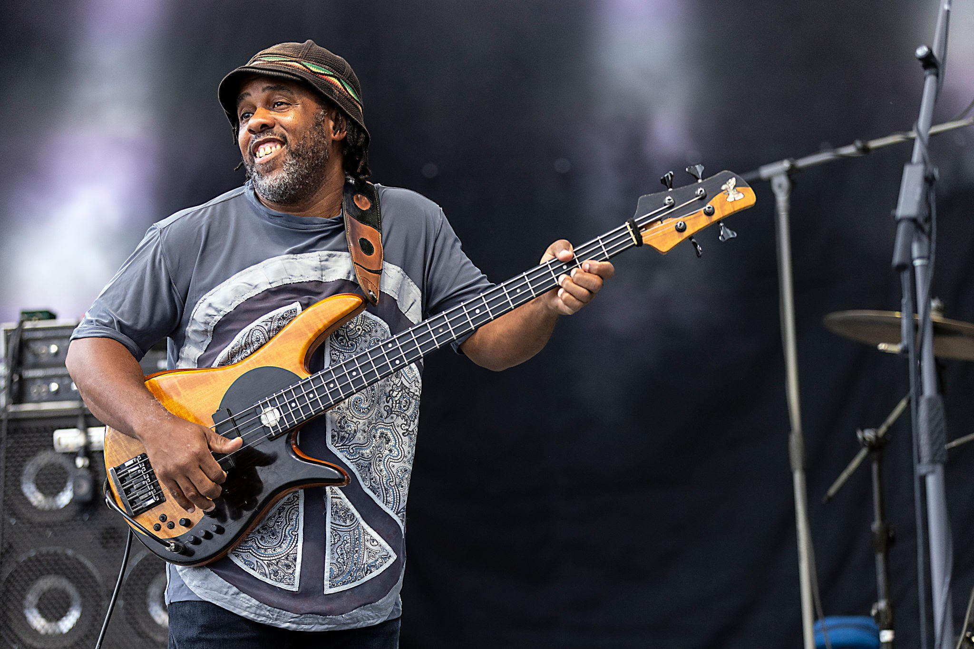
On practicing
Dave Weckl “You want to practice your technique so that when you’re playing a song and your creativity tells you to play a certain thing, then your body knows how to turn those creative thoughts into music.” *
Victor Wooten “Improvisation is like saying something. So, first, you have to have something to say.” *
Photo credits: Paul Bergen/Redferns.
Jeff Hahne/Getty Images.
*) Paraphrase

Slide 8
On practicing
Write
to sharpen your thinking
to convey ideas and solutions (without ambiguity)
Simplify solutions
to sharpen your thinking
Look for opportunities to explain your work
so you learn the questions
Learn and understand what others do
Build your vision, and try it out
so you find the problems
Take breaks

Slide 9
On impact
Freedom to innovate
Teach
Need: funding / team / community / users
Ideas vs long-term projects
Career paths
Teacher
Administrator
Manager
Mentor
Individual contributor
Technical leader

Slide 10
On collaboration
Author ordering
Hardy & Littlewood; Leino & Müller
Be willing to decline / not insist on co-authorship
Acknowledgments
Building on previous work is good
Describe what is different, if anything
There is power to saying “This is just like … ”
Be able to hold more than one thought in your head at the same time
Read the papers you cite
Diversity

Slide 11
On writing
Write often
EWD notes, blogs
Reduce ambitions
Imagine your audience
Referees?
More senior colleagues in the field?
Peers?
A future person?
Students?
More important than publishing in a high-prestigious conference are the research results themselves
Many keystone papers were not at such conferences
But the initial visibility is great
“I’m working on a POPL paper” – red flag
Conference-submission deadlines are great
Hurrah for Tutorial Papers at the upcoming FM 2024!

Slide 12
On organization
Ask someone else

Slide 13
On being yourself
Be yourself
Follow your passion, your vision
“Do what you love” [Erika Ábrahám]
“Do what only you can do” [Edsger W. Dijkstra]
When you feel energy for something, act on it
POPL 1997 referee comment: “Verification, isn’t that passé?”
“Do not depend on the hope of results. … As you get used to this idea, you start more and more to concentrate not on the results, but the value, the rightness, the truth of the work itself.” [Thomas Merton]
If not results, then how do you identify the line between pioneer and waste-of-time?
peer reviews
other sounding boards (not your Mom)
look not just for confirmation, but also for counterevidence
be willing to adjust your course, don’t be too dogmatic

Slide 14
Program safely!

