Slide 1
Writing proofs in Dafny
K. Rustan M. Leino Amazon Web Services
14 October 2024 Tutorial, FMCAD 2024 Prague, Czech Republic

Slide 2
Goals of tutorial
Show how to write and debug proofs
Expand your mind about how to describe mechanical proofs
Demonstrate Dafny as a competent, automated proof assistant
Inspire you to write your next verified programs and proofs in Dafny (and teach using Dafny)

Slide 3

Language
Dafny (dafny.org)
Programming language
Java-like
Verification-aware (proof-oriented)
Constructs for
Imperative programming
Functional programming
Specifications
Proofs
VS Code integration

Slide 4
Tools
Static verifier
Compilers from Dafny to
Java
C#
JavaScript
Go
Python
Rust
Auditor
Test generator

Slide 5
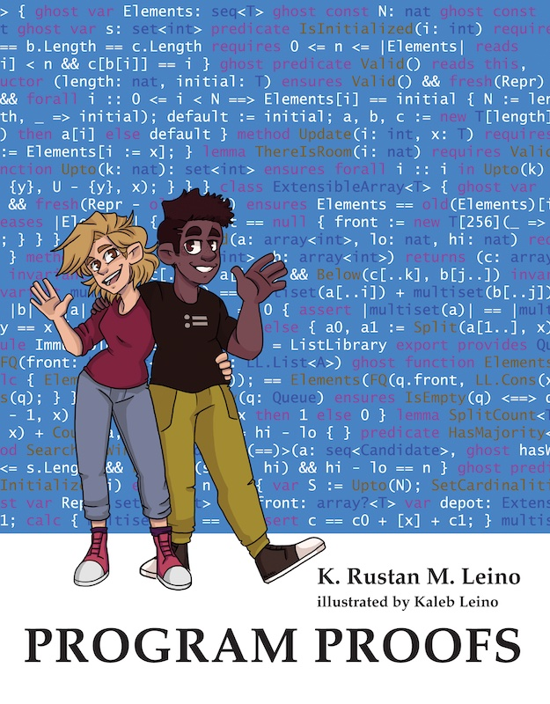

Some uses of Dafny
Teaching
Over a decade, many universities
Book (MIT Press): program-proofs.com
At AWS
AWS Encryption SDK
AWS Database Encryption SDK
AWS’s authentication engine Talk at AWS re:Inforce 2024: https://youtu.be/oshxAJGrwMU?si=2HRf2XvNR-8RMIXZ
…
…

Slide 6
A comparison with Lean* (actually, Dafny is more similar to Why3, F*, SPARK Ada, or Viper)
Program-centered – built-in support for pre- and postconditions and invariants
Preconditions are used everywhere
Built-in mutable objects (no monads, but :- for handling failures)
nat is a subset of int (not an inductively defined type)
A predicate is just a function that returns bool
There is no Prop and no values of type “proof”
Traits (abstract supertypes) are used more often than higher-order functions
One, fixed well-founded order for termination checking
Order of declarations is immaterial
least/greatest predicates (”inductive/condinductive predicates”) are functions, not data
Codatatypes, corecursion, and coinduction are supported
Supports induction recursion
No tactics
IDE: no window for proof state
…
*) since this Dafny tutorial at FMCAD was preceded by a tutorial on Lean and many audience members attended both

Slide 7
Methods vs functions
method M(x: int) returns (y: int) { <statements> }
Can mutate state
Can be nondeterministic
Opaque (reasoning uses specification, never the body)
function F(x: int): int { <expr> }
Cannot mutate state
Deterministic
Transparent (reasoning uses body) – default or opaque – by declaration

Slide 8
Statements vs expressions
statement | expression
if G { <statements> } else { <statements> } | if G then <expr> else <expr>
match E case Nil => <statements> case Cons(x, tail) => <statements> | match E case Nil => <expr> case Cons(x, tail) => <expr>
optional

Slide 9
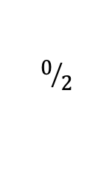
Preliminaries
Preliminaries.dfy
$$0/2$$
method Double(x: int) returns (r: int)
ensures r == 2 * x
{
r := x + x;
}
method Double'(x: int) returns (r: int)
ensures r == 2 * x
{
if x < 0 {
r := x + x;
} else {
var y := 3 * x;
r := y - x;
}
}

Slide 10
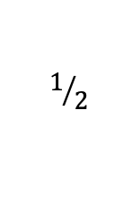
Preliminaries
Preliminaries.dfy
method Double''(x: nat) returns (r: int)
ensures r == 2 * x
{
if x == 0 {
return 0;
} else {
r := Double''(x - 1);
assert r == 2 * (x - 1) == 2 * x - 2;
r := r + 2;
}
}
method Double'3(x: nat) returns (r: int)
ensures r == 2 * x
{
r := 0;
var i := 0;
while i < x
invariant 0 <= i <= x
invariant 0 <= r
invariant r == 2 * i
{
r := r + 2;
i := i + 1;
}
assert i == x;
}
$$1/2$$

Slide 11
Binary search
method BinarySearch(a: array<int>, key: int) returns (r: int)
requires forall i, j :: 0 <= i < j < a.Length ==> a[i] <= a[j]
ensures 0 <= r ==> r < a.Length && a[r] == key
ensures r < 0 ==> key !in a[..]
{
var lo, hi := 0, a.Length;
while lo < hi
invariant 0 <= lo <= hi <= a.Length
invariant key !in a[..lo] && key !in a[hi..]
{
var mid := (lo + hi) / 2;
if a[mid] == key {
return mid;
} else if key < a[mid] {
hi := mid;
} else {
lo := mid + 1;
}
}
return -1;
}

Slide 12
Binary search with bounded integers
newtype int32 = x | -0x8000_0000 <= x < 0x8000_0000
method BinarySearch(a: array<int>, key: int) returns (r: int32)
requires forall i, j :: 0 <= i < j < a.Length ==> a[i] <= a[j]
requires a.Length < 0x8000_0000
ensures 0 <= r ==> r < a.Length as int32 && a[r] == key
ensures r < 0 ==> key !in a[..]
{
var lo, hi := 0, a.Length as int32;
while lo < hi
invariant 0 <= lo <= hi <= a.Length as int32
invariant key !in a[..lo] && key !in a[hi..]
{
assert (lo as int + hi as int) / 2 ==
(lo + (hi - lo) / 2) as int;
var mid := lo + (hi - lo) / 2;
if a[mid] == key {
return mid;
} else if key < a[mid] {
hi := mid;
} else {
lo := mid + 1;
}
}
return -1;
}

Slide 13
Minimum
method Min(s: seq<int>) returns (m: int)
requires |s| != 0
ensures m in s
ensures forall j :: 0 <= j < |s| ==> m <= s[j]
{
m := s[0];
for i := 1 to |s|
invariant m in s
invariant forall j :: 0 <= j < i ==> m <= s[j]
{
if s[i] < m {
m := s[i];
}
}
}

Slide 14
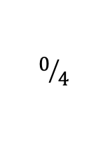
Logic
Logic.dfy
$$0/4$$
predicate P(x: int)
predicate Q(x: int)
lemma {:axiom} EstablishP(x: int)
ensures P(x)
lemma {:axiom} EstablishQ(x: int)
ensures Q(x)
lemma EstablishPAndQ(x: int)
ensures P(x) && Q(x)
{
EstablishP(x);
EstablishQ(x);
}
lemma EstablishPOrQ(x: int)
ensures P(x) || Q(x)
{
if * {
EstablishP(x);
} else {
EstablishQ(x);
}
}

Slide 15
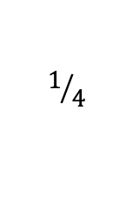
Logic
Logic.dfy
$$1/4$$
predicate P(x: int)
predicate Q(x: int)
lemma {:axiom} GivenPEstablishQ(x: int)
requires P(x)
ensures Q(x)
lemma EstablishPImpliesQ(x: int)
ensures P(x) ==> Q(x)
{
if P(x) {
GivenPEstablishQ(x);
}
}
lemma Or(x: int, y: int)
requires P(x) || P(y)
ensures Q(x) || Q(y)
{
if P(x) {
GivenPEstablishQ(x);
} else {
GivenPEstablishQ(y);
}
}

Slide 16
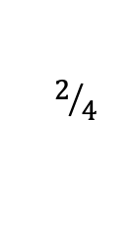
Logic
Logic.dfy
$$2/4$$
predicate P(x: int)
predicate Q(x: int)
lemma ModusPonens(x: int)
requires L0: P(x)
requires L1: P(x) ==> Q(x)
ensures Q(x)
{
calc {
true;
==> { reveal L0; }
P(x);
==> { reveal L1; }
Q(x);
}
}
lemma ModusTollens(x: int)
requires L0: !Q(x)
requires L1: P(x) ==> Q(x)
ensures !P(x)
{
if P(x) {
assert Q(x) by {
reveal L1;
}
assert false by {
reveal L0;
}
} else {
// easy!
}
}

Slide 17
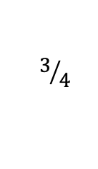
Logic
Logic.dfy
$$3/4$$
predicate P(x: int)
predicate Q(x: int)
lemma {:axiom} GivenPEstablishQ(x: int)
requires P(x)
ensures Q(x)
lemma AllQ()
ensures forall x :: P(x) ==> Q(x)
{
forall x | P(x)
ensures Q(x)
{
GivenPEstablishQ(x);
}
}
lemma Exists()
requires exists x :: P(x)
ensures exists z :: Q(z)
{
var y :| P(y);
GivenPEstablishQ(y);
}
lemma Exists'(x: int) returns (z: int)
requires P(x)
ensures Q(z)
{
GivenPEstablishQ(x);
z := x;
}

Slide 18
Opaque functions
opaque function F(x: int): int {
x + 15
}
lemma Test(x: int) {
reveal F();
assert x < F(x);
}
lemma AboutF(x: int)
ensures F(x) == x + 15
{
reveal F();
}
lemma TestOne(x: int) {
AboutF(x);
assert x < F(x);
}

Slide 19
Coincidence count
function InBoth(a: seq<int>, b: seq<int>): set<int> {
set x | x in a && x in b
}
method CoincidenceCount(a: seq<int>, b: seq<int>) returns (c: nat)
requires forall i, j :: 0 <= i < j < |a| ==> a[i] < a[j]
requires forall i, j :: 0 <= i < j < |b| ==> b[i] < b[j]
ensures c == |InBoth(a, b)|
{
c := 0;
var i, j := 0, 0;
while i < |a| && j < |b|
invariant 0 <= i <= |a| && 0 <= j <= |b|
invariant |InBoth(a, b)| == c + |InBoth(a[i..], b[j..])|
{
if a[i] == b[j] {
assert InBoth(a[i..], b[j..]) ==
{a[i]} + InBoth(a[i + 1..], b[j + 1..]);
c, i, j := c + 1, i + 1, j + 1;
} else if a[i] < b[j] {
assert InBoth(a[i..], b[j..]) == InBoth(a[i + 1..], b[j..]);
i := i + 1;
} else {
assert InBoth(a[i..], b[j..]) == InBoth(a[i..], b[j + 1..]);
j := j + 1;
}
}
}

Slide 20
A variation on Fibonacci
ghost function Fibly(x: nat): int {
if x < 2 then x else Fibly(x - 2) - Fibly(x - 1)
}
method ComputeFibly(n: nat) returns (r: int)
ensures r == Fibly(n)
{
r := 0;
var s := 1;
for i := 0 to n
invariant r == Fibly(i) && s == Fibly(i + 1)
{
r, s := s, r - s;
}
}

Slide 21
Termination
A decreases clause defines the termination metric for each method/function activation
It is evaluated on entry to the method/function
The termination metric from one method/function activation to the next must decrease in a well-founded order ≻
Dafny fixes ≻

Slide 22
Defining termination metrics
method Apple(m: nat)
decreases 100 * m
{
if 1 <= m < 50 {
Banana(80 - m);
var c := Cherry(m);
}
}
method Banana(n: nat)
decreases n + 19
…
function Cherry(p: nat): nat
decreases p / 2
…
For a general activation of Apple
Apple(m)
100 * m
100 * m ≻ 99 - m
✅
Banana(80 - m)
99 - m
100 * m ≻ m / 2
✅
Cherry(m)
m / 2

Slide 23
Well-founded ordered for other types
type | X ≻ y
inductive datatype | X structurally includes y
int | 0 ≤ X ⋀ y < X equivalently: 0 ≤ X ⋀ y + 1 ≤ X
real | 0.0 ≤ X ⋀ y + 1.0 ≤ X
bool | X ⋀ ¬y
object? | X ≠ null ⋀ y = null
set<T> | y ⊊ X
seq<T> | Y is proper subsequence of X
iset<T> | false

Slide 24
Commutativity of Mul
lemma {:induction false} MulCommutative(a: nat, b: nat)
ensures Mul(a, b) == Mul(b, a)
{
if a == b {
} else if a == 0 {
assert Mul(a, b) == Mul(a, b - 1) by { reveal Mul(); }
assert Mul(b, a) == 0 == Mul(b - 1, a) by { reveal Mul(); }
MulCommutative(a, b - 1);
} else if b < a {
MulCommutative(b, a);
} else {
calc {
Mul(a, b);
{ reveal Mul(); }
a + Mul(a, b - 1);
{ MulCommutative(a, b - 1); }
a + Mul(b - 1, a);
{ reveal Mul(); }
a + b - 1 + Mul(b - 1, a - 1);
{ MulCommutative(a - 1, b - 1); }
a + b - 1 + Mul(a - 1, b - 1);
{ reveal Mul(); }
b + Mul(a - 1, b);
{ MulCommutative(a - 1, b); }
b + Mul(b, a - 1);
{ reveal Mul(); }
Mul(b, a);
}
}
}
opaque function Mul(a: nat, b: nat): nat {
if b == 0 then 0 else a + Mul(a, b - 1)
}
How cool is this step?
Yep, pretty cool, alright!
Here’s another interesting step. Notice how the arguments are reversed in the recursive call (that is, to call to the induction hypothesis).

Slide 25
Shorter, but less readable, proof
function Mul(a: nat, b: nat): nat {
if b == 0 then 0 else a + Mul(a, b - 1)
}
lemma MulCommutative(a: nat, b: nat)
ensures Mul(a, b) == Mul(b, a)
{
if 0 < a < b {
MulCommutative(a - 1, b);
}
}

Slide 26
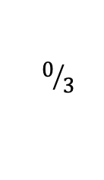
Least predicates (predicates defined as a least fixpoint)
INC.dfy
$$0/3$$
datatype Cmd = Inc | Seq(Cmd, Cmd) | Repeat(Cmd)
type State = int
least predicate BigStep(c: Cmd, s: State, t: State) {
match c
case Inc =>
t == s + 1
case Seq(c0, c1) =>
exists s' :: BigStep(c0, s, s') && BigStep(c1, s', t)
case Repeat(c0) =>
|| s == t
|| exists s' :: BigStep(c0, s, s') && BigStep(c, s', t)
}

Slide 27
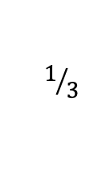
Lemma about a least predicate
INC.dfy
$$1/3$$
least lemma {:induction false}
Monotonic(c: Cmd, s: State, t: State)
requires BigStep(c, s, t)
ensures s <= t
{
match c
case Inc =>
case Seq(c0, c1) =>
var s' :| BigStep(c0, s, s') && BigStep(c1, s', t);
Monotonic(c0, s, s');
Monotonic(c1, s', t);
case Repeat(c0) =>
if s != t {
var s' :| BigStep(c0, s, s') && BigStep(c, s', t);
Monotonic(c0, s, s');
Monotonic(c, s', t);
}
}

Slide 28
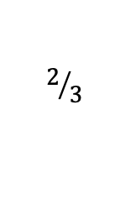
Same lemma, but with automatic induction
INC.dfy
$$2/3$$
least lemma Monotonic(c: Cmd, s: State, t: State)
requires BigStep(c, s, t)
ensures s <= t
{
// proof is automatic
}

Slide 29
Brief show and tell
Possibly infinite unary numbers
codatatype
Co-recursive calls
greatest lemma
Wildcard
Operational vs declarative specification

Slide 30
Conclusion
Use Dafny to
Write verified programs
Write a verified part of a larger program written in some other language
Formalize your models
Teach!
Program safely!

Slide 31
Additional examples

Slide 32
Pow
opaque ghost function Pow(n: nat): nat {
if n == 0 then 1 else 2 * Pow(n - 1)
}
lemma PowPlus(m: nat, n: nat)
ensures Pow(m + n) == Pow(m) * Pow(n)
{
if m == 0 {
assert Pow(0) == 1 by {
reveal Pow();
}
} else {
calc {
Pow(m + n);
{ reveal Pow(); }
2 * Pow(m - 1 + n);
{ PowPlus(m - 1, n); }
2 * Pow(m - 1) * Pow(n);
{ reveal Pow(); }
Pow(m) * Pow(n);
}
}
}

Slide 33
FastPow
function FastPow(n: nat): nat {
if n == 0 then 1 else
var p := FastPow(n / 2);
if n % 2 == 0 then
p * p
else
2 * p * p
}
lemma {:induction false} Same(n: nat)
ensures Pow(n) == FastPow(n)
{
if n == 0 {
assert Pow(n) == 1 by {
reveal Pow();
}
} else {
var h := n / 2;
Same(h);
PowPlus(h, h);
if n % 2 == 0 {
assert n == h + h;
} else {
assert n == h + h + 1;
assert Pow(n) == 2 * Pow(n - 1) by {
reveal Pow();
}
}
}
}

Slide 34
Sum
ghost function Sum(s: set<int>): int {
if s == {} then 0 else
var x := Pick(s);
Sum(s - {x}) + x
}
ghost function Pick(s: set<int>): int
requires s != {}
{
var x :| x in s; x
}
lemma ExtendSum(s: set<int>, x: int)
requires x !in s
ensures Sum(s + {x}) == Sum(s) + x
{
var s' := s + {x};
var y := Pick(s');
if x != y {
var t := s - {y};
calc {
Sum(s');
Sum(s' - {y}) + y;
{ assert s' - {y} == t + {x}; }
Sum(t + {x}) + y;
{ ExtendSum(t, x); }
Sum(t) + x + y;
{ ExtendSum(t, y); }
Sum(t + {y}) + x;
{ assert t + {y} == s; }
Sum(s) + x;
}
}
}

Slide 35
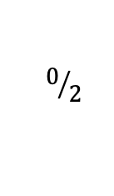
Optimize
Optimize.dfy
$$0/2$$
datatype Expr =
| Const(value: int)
| Var(name: string)
| Binary(op: BinOp, 0: Expr, 1: Expr)
{
function Eval(env: Env): int {
match this
case Const(n) => n
case Var(name) =>
if name in env then env[name] else 0
case Binary(op, e0, e1) =>
op.Eval(e0.Eval(env), e1.Eval(env))
}
// …
}
type Env = map<string, int>
datatype BinOp = Plus | Minus
{
function Eval(a: int, b: int): int {
match this
case Plus => a + b
case Minus => a - b
}
}

Slide 36
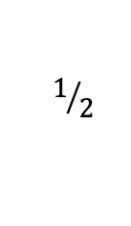
Optimize
datatype Expr = // …
{ // …
function Optimize(): Expr {
match this
case Binary(op, e0, e1) =>
var e0, e1 := e0.Optimize(), e1.Optimize();
if e0.Const? && e1.Const? then
Const(op.Eval(e0.value, e1.value))
else
this
case _ => this
}
lemma OptimizeCorrect(env: Env)
ensures Eval(env) == Optimize().Eval(env)
{
match this
case Binary(op, e0, e1) =>
e0.OptimizeCorrect(env);
e1.OptimizeCorrect(env);
case _ =>
}
}
Optimize.dfy
$$1/2$$

