Slide 1
B3: a next-generation intermediate verification language
K. Rustan M. Leino
Amazon Web Services
PNW PLSE 2025
7 May 2025
Seattle, WA, USA

Slide 2
Verification architecture
What the user sees
Programming language
Specification language
Proof language
Programming methodology
Source
“possible precondition violation on line 218”
Frontend verifier
Focus in this talk
Intermediate Verification Language (IVL)
Backend verifier
Automatic
Logical formula
Semi-decision procedures
”valid” or “don’t know”

Slide 3
Common IVLs
Boogie 2
  imperative
Why3
  functional
Viper
  permissions
…

Slide 4
Language design motto
A language helps users think by encouraging certain kinds of thinking

Slide 5
Observation from experience
Verification does better with smaller contexts

Slide 6
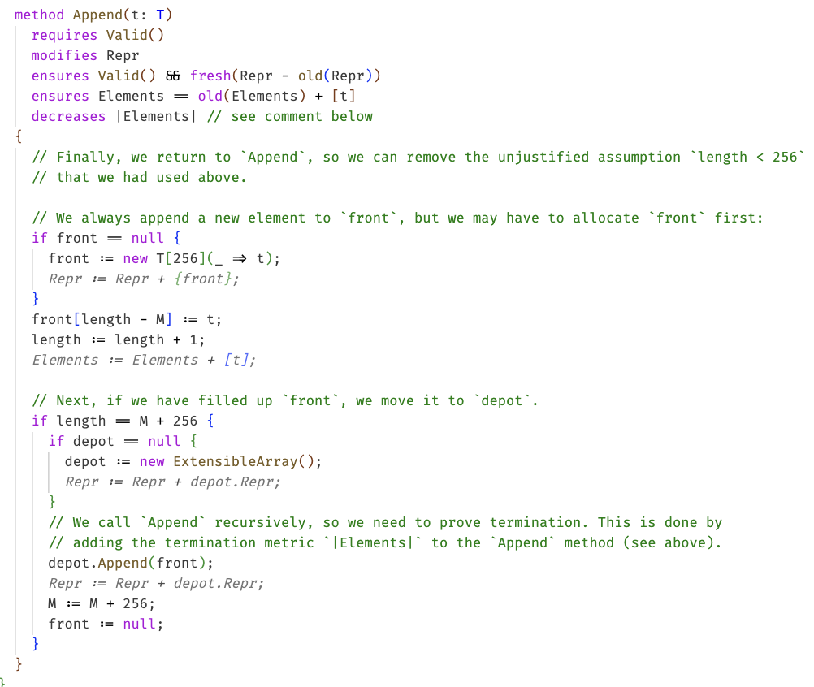
Discharging proof obligations
Verification-condition generation
Symbolic execution
𝝓
𝝓
𝝓
𝝓
𝝓

Slide 7
Call statements
A procedure call is like an information exchange protocol
check precondition
then, learn postcondition
Note, pre- and postconditions need not be the same (of course!)

Slide 8
Partial expressions
Well-formedness checks (e.g., divisor is non-zero) use a similar protocol
Given
function F(x: int): int
requires 0 <= x < 100
At call site of F(e):
  Check 0 <= e < 100
  Learn F#CanCall(e)

Slide 9
Dafny’s Boogie encoding (simplified)
function F(x: int): int
requires 0 <= x < 100
function G(y: int): int
requires 5 <= y < 22
r := F(23) == 8 && G(n) < 72;
Dafny
Boogie
var x := 23;
assert {:subsumption 0} 0 <= x;
assert {:subsumption 0} x < 100;
assume 0 <= x && x < 100;
assume F#CanCall(23);
if (F(23) == 8) {
var y := n;
assert {:subsumption 0} 5 <= y;
assert {:subsumption 0} y < 22;
assume 5 <= y && y < 22;
assume G#CanCall(n);
}
assume F#CanCall(23) && (F(23) == 8 ==> G#CanCall(n));
r := F(23) == 8 && G(n) < 72;

Slide 10
Check and learn
function F(x: int): int
requires 0 <= x < 100
function G(y: int): int
requires 5 <= y < 22
r := F(23) == 8 && G(n) < 72;
Dafny
B3
val x := 23
check 0 <= x
check x < 100
learn F#CanCall(23)
if F(23) == 8 {
val y := n
check 5 <= y
check y < 22
learn G#CanCall(n)
}
r := F(23) == 8 && G(n) < 72

Slide 11
Check and learn
val x := 23
check 0 <= x
check x < 100
learn F#CanCall(23)
if F(23) == 8 {
val y := n
check 5 <= y
check y < 22
learn G#CanCall(n)
}
assume F(23) == 8 ==> G#CanCall(n)
assume F#CanCall(23)

Slide 12
B3 features
Symbolic execution
check and learn statements
Vet, enforce, use (contracts and loop specifications)
Precise error handling
Dependency management
No polymorphism
inout parameters instead of global variables
where clauses
Lambda lifting
Custom attributes

Slide 13
Summary
B3 is a new (in design/development) intermediate verification language aimed at providing a foundation for building the next decade’s program verifiers

