Slide 1
The role of termination in program verification
K. Rustan M. Leino
18-20 March 2026
PhD Open, U Warsaw
Warsaw, Poland

Slide 2
Goal of lectures
To review basics of program verification, and
to give a perspective on
induction / well-founded recursion
as a common thread in
programming, function definitions, and proofs
Take-home message:
You can call whatever you want whenever you want, provided
  you satisfy the precondition, and
  you can show a decrease in some fixed well-founded order
Lecture 0

Slide 3

Vehicle for our journey
Dafny (dafny.org)
Programming language
  General purpose
  Verification-aware
  (proof-oriented)
Constructs for
  Imperative programming
  Functional programming
  Specifications
  Proofs
VS Code integration
AI friendly
  LLMs do well with Dafny

Slide 4
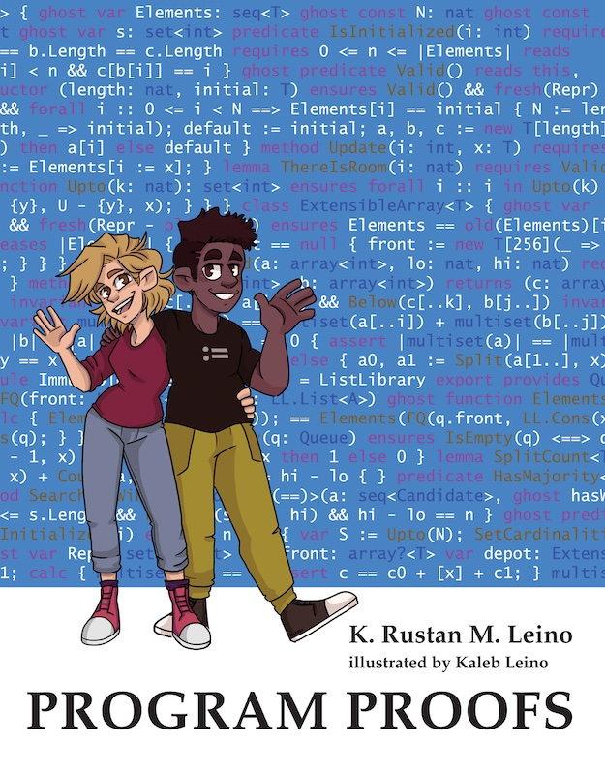

Some uses of Dafny
Teaching
  Over a decade, many universities
  Book (MIT Press): program-proofs.com
At AWS
  AWS Encryption SDK
  AWS Database Encryption SDK
  AWS’s authorization engine
  Paper at ICSE 2025.
  Talk at AWS re:Inforce 2024:
  https://youtu.be/oshxAJGrwMU
  …
Research projects
…

Slide 5
Methods and pre-/post-conditions
CombineSplit.dfy
method Split(c: int) returns (a: int, b: int)
requires 0 <= c < 10_000
ensures 0 <= a < 100 && 0 <= b < 100
ensures c == 100 * a + b
{
a := c / 100;
b := c % 100;
}
method Combine(a: int, b: int) returns (c: int)
requires 0 <= a < 100 && 0 <= b < 100
ensures 0 <= c < 10_000
ensures c == 100 * a + b
{
if a == 0 {
c := b;
} else if a == 1 {
c := 100 + b;
} else {
c := 100 * a + b;
}
}
method Caller(c: int)
requires 0 <= c < 10_000
{
var a, b := Split(c);
var d := Combine(a, b);
assert c == d;
}

Slide 6
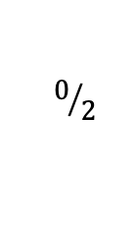
Loop invariants
Double.dfy
$$0/2$$
method Double(x: int) returns (r: int)
ensures r == 2 * x
{
r := x + x;
}
method Double'(x: int) returns (r: int)
ensures r == 2 * x
{
if x < 0 {
r := x + x;
} else {
var y := 3 * x;
r := y - x;
}
}

Slide 7
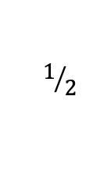
Loop invariants
Double.dfy
method Double''(x: nat) returns (r: int)
ensures r == 2 * x
{
if x == 0 {
return 0;
} else {
r := Double''(x - 1);
assert r == 2 * (x - 1) == 2 * x - 2;
r := r + 2;
}
}
method Double'3(x: nat) returns (r: int)
ensures r == 2 * x
{
r := 0;
var i := 0;
while i < x
invariant 0 <= i <= x
invariant 0 <= r
invariant r == 2 * i
{
r := r + 2;
i := i + 1;
}
assert i == x;
}
$$1/2$$

Slide 8
Interacting with the verifier
Min.dfy
method Min(s: seq<int>) returns (m: int)
requires |s| != 0
ensures m in s
ensures forall j :: 0 <= j < |s| ==> m <= s[j]
{
m := s[0];
for i := 1 to |s|
invariant m in s
invariant forall j :: 0 <= j < i ==> m <= s[j]
{
if s[i] < m {
m := s[i];
}
}
}

Slide 9
Binary search
method BinarySearch(a: array<int>, key: int) returns (r: int)
requires forall i, j :: 0 <= i < j < a.Length ==> a[i] <= a[j]
ensures 0 <= r ==> r < a.Length && a[r] == key
ensures r < 0 ==> key !in a[..]
{
var lo, hi := 0, a.Length;
while lo < hi
invariant 0 <= lo <= hi <= a.Length
invariant key !in a[..lo] && key !in a[hi..]
{
var mid := (lo + hi) / 2;
if a[mid] == key {
return mid;
} else if key < a[mid] {
hi := mid;
} else {
lo := mid + 1;
}
}
return -1;
}

Slide 10
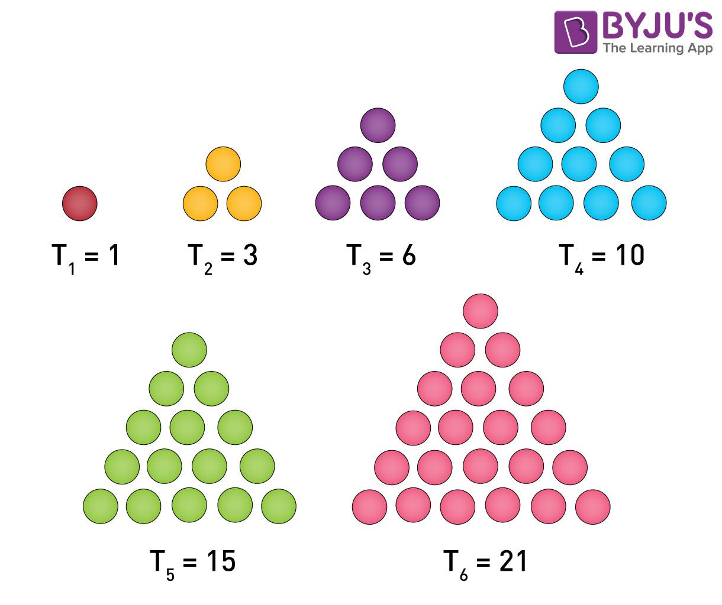
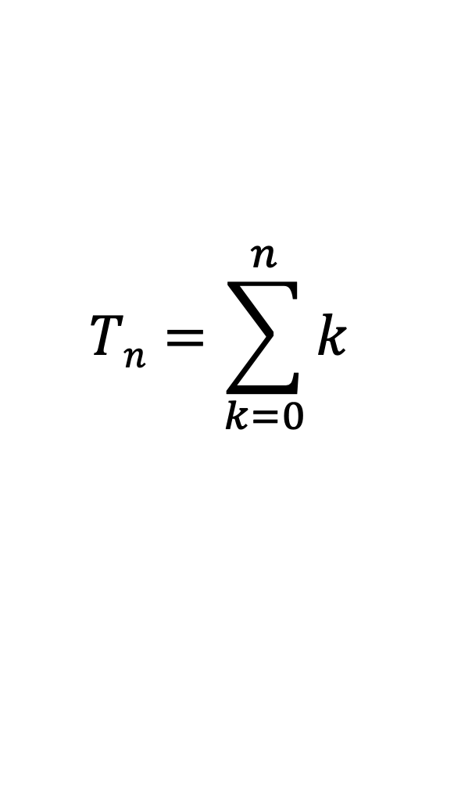
Triangle numbers
function Triangle(n: nat): nat {
if n == 0 then 0 else Triangle(n – 1) + n
}
$$Tn=\sum_{k=0}^{n}{k}$$
Image credit: byjus.com
Lecture 1

Slide 11
Methods vs functions
method M(x: int) returns (y: int) {
<statements>
}
Can mutate state
Can be nondeterministic
Opaque (reasoning uses specification, never the body)
function F(x: int): int {
<expr>
}
Cannot mutate state
Deterministic
Transparent (reasoning uses body) – default
or opaque

Slide 12
Statements vs expressions
statement | expression
if G { <statements> } else { <statements> } | if G then <expr> else <expr>
match E case Nil => <statements> case Cons(x, tail) => <statements> | match E case Nil => <expr> case Cons(x, tail) => <expr>
optional

Slide 13
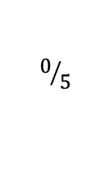
Methods and lemmas
Triangle.dfy
$$0/5$$
method Gauss(n: nat) returns (t: nat)
ensures t == Triangle(n)
{
t := 0;
var i := 0;
while i < n
invariant 0 <= i <= n
invariant t == Triangle(i)
{
i := i + 1;
t := t + i;
}
}

Slide 14
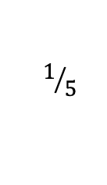
Methods and lemmas
Triangle.dfy
$$1/5$$
method Gauss(n: nat) returns (t: nat)
ensures t == Triangle(n)
ensures t == n * (n + 1) / 2
{
t := 0;
var i := 0;
while i < n
invariant 0 <= i <= n
invariant t == Triangle(i)
invariant t == i * (i + 1) / 2
{
i := i + 1;
t := t + i;
}
}

Slide 15
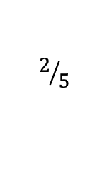
Methods and lemmas
Triangle.dfy
$$2/5$$
method Gauss(n: nat) returns (t: nat)
ensures t == Triangle(n)
ensures Triangle(n) == n * (n + 1) / 2
{
t := 0;
var i := 0;
while i < n
invariant 0 <= i <= n
invariant t == Triangle(i)
invariant Triangle(i) == i * (i + 1) / 2
{
i := i + 1;
t := t + i;
}
}

Slide 16
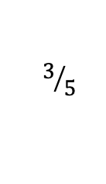
Methods and lemmas
Triangle.dfy
$$3/5$$
method Gauss(n: nat)
ensures Triangle(n) == n * (n + 1) / 2
{
var i := 0;
while i < n
invariant 0 <= i <= n
invariant Triangle(i) == i * (i + 1) / 2
{
i := i + 1;
}
}

Slide 17
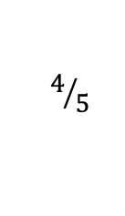
Methods and lemmas
Triangle.dfy
$$4/5$$
lemma Gauss(n: nat)
ensures Triangle(n) == n * (n + 1) / 2
{
var i := 0;
while i < n
invariant 0 <= i <= n
invariant Triangle(i) == i * (i + 1) / 2
{
i := i + 1;
}
}

Slide 18
lemma
≈ method
Stating and proving a lemma is just another application of program logic
(Note: not based on Curry-Howard correspondence)
For both methods and lemmas, you have to establish the postcondition for every input and every control path
Calling a method/lemma obtains the information from its postcondition (and, for methods, experiences any side effects)
Methods that call themselves are known as recursive
Lemmas that call themselves are known as inductive
These are really the same!

Slide 19
The need for termination: methods
method M(x: int)
ensures P(x)
{
M(x);
}
method Caller(x: int)
{
M(x);
assert P(x);
…
}

Slide 20
The need for termination: lemmas
lemma L(x: int)
ensures P(x)
{
L(x);
}
method Caller(x: int)
{
L(x);
assert P(x);
…
}

Slide 21
The need for termination: functions
function F(x: int): int {
1 + F(x)
}
method Caller()
{
assert F(5) == 1 + F(5);
assert false;
…
}

Slide 22
How to establish termination
Main()
M(45, 10)
P(25)
Q(102)
S(10)
P(100)
M(45, 12)
R()
S(9)
…
M(31, 0)
S(8)
…

Slide 23
How to establish termination: associate a termination metric with each method activation
Main()
280
M(45, 10)
P(25)
63
275
Q(102)
229
S(10)
0
20
P(100)
M(45, 12)
274
R()
S(9)
227
100
…
M(31, 0)
S(8)
90
63
…

Slide 24
Desired property for each call
If each call
Caller()
x
Callee()
y
satisfies x ≻ y
in a fixed well-founded order ≻ ,
then all calls in the program terminate

Slide 25
Well-founded order
An irreflexive partial order ≻ on a set 𝒜 is
well-founded
if there is no infinite descending chain
a₀ ≻ a₁ ≻ a₂ ≻ a₃ ≻ …
Example: The natural numbers with the usual
greater-than ordering > is well-founded.

Slide 26
Defining termination metrics
A decreases clause defines the termination metric for each method/function activation
It is evaluated on entry to the method/function
method Apple(m: nat)
decreases 100 * m
{
if 1 <= m < 50 {
Banana(80 - m);
var c := Cherry(m);
}
}
method Banana(n: nat)
decreases n + 19
…
function Cherry(p: nat): nat
decreases p / 2
…
For an activation Apple(4)
Apple(4)
400
400 ≻ 95 ✅
Banana(76)
95
400 ≻ 2 ✅
Cherry(4)
2

Slide 27
Defining termination metrics
A decreases clause defines the termination metric for each method/function activation
It is evaluated on entry to the method/function
method Apple(m: nat)
decreases 100 * m
{
if 1 <= m < 50 {
Banana(80 - m);
var c := Cherry(m);
}
}
method Banana(n: nat)
decreases n + 19
…
function Cherry(p: nat): nat
decreases p / 2
…
For a general activation of Apple
Apple(m)
100 * m
100 * m ≻ 99 - m
✅
Banana(80 - m)
99 - m
100 * m ≻ m / 2
✅
Cherry(m)
m / 2

Slide 28
Examples
function Triangle(n: nat): nat
decreases n
{
if n == 0 then 0 else n + Triangle(n - 1)
}
function Factorial(n: nat): nat
decreases n
{
if n > 0 then n * Factorial(n - 1) else 1
}
function Fib(n: nat): nat
decreases n
{
if n < 2 then n else Fib(n - 2) + Fib(n - 1)
}

Slide 29
Default decreases clause
function Triangle(n: nat): nat
decreases n
{
if n == 0 then 0 else n + Triangle(n - 1)
}
function Factorial(n: nat): nat
decreases n
{
if n > 0 then n * Factorial(n - 1) else 1
}
function Fib(n: nat): nat
decreases n
{
if n < 2 then n else Fib(n - 2) + Fib(n - 1)
}
An omitted decreases clause defaults to the method/function parameter
/////
(n:

Slide 30
More examples
SumRange.dfy
  Manual decreases clause
function SumRange(s: seq<int>, lo: int, hi: int): int
requires 0 <= lo <= hi <= |s|
decreases hi - lo
{
if hi == lo then 0 else s[lo] + SumRange(s, lo+1, hi)
}

Slide 31
More examples
Pow.dfy
  More interesting proof
// Return 2^{n}
opaque function Pow(n: nat): nat
{
if n == 0 then 1 else 2 * Pow(n - 1)
}
lemma PowDistributesOverAddition(m: nat, n: nat)
ensures Pow(m + n) == Pow(m) * Pow(n)
{
if m == 0 {
reveal Pow(); // def. Pow
} else {
calc {
Pow(m + n);
== { reveal Pow(); } // def. Pow
2 * Pow(m - 1 + n);
== { PowDistributesOverAddition(m - 1, n); } // I.H.
2 * (Pow(m - 1) * Pow(n));
==
2 * Pow(m - 1) * Pow(n);
== { reveal Pow(); } // def. Pow
Pow(m) * Pow(n);
}
}
}

Slide 32
Sort with boolean keys
TwoSort.dfy
type Payload
datatype Data = Data(key: bool, payload: Payload)
method TwoSort(a: array<Data>)
modifies a
ensures forall i, j :: 0 <= i < j < a.Length ==> !a[i].key || a[j].key
Lecture 2 (lab)

Slide 33
Sort with boolean keys: solution (variation 0)
TwoSort.dfy
method TwoSort(a: array<Data>)
modifies a
ensures forall i, j :: 0 <= i < j < a.Length ==> !a[i].key || a[j].key
{
var lo, hi := 0, a.Length;
while lo < hi
invariant 0 <= lo <= hi <= a.Length
invariant forall i :: 0 <= i < lo ==> !a[i].key
invariant forall i :: hi <= i < a.Length ==> a[i].key
decreases hi - lo
{
if !a[lo].key {
lo := lo + 1;
} else if a[hi - 1].key {
hi := hi - 1;
} else {
a[lo], a[hi - 1] := a[hi - 1], a[lo];
lo := lo + 1;
hi := hi - 1;
}
}
}

Slide 34
Sort with boolean keys: solution (variation 1)
TwoSort.dfy
method TwoSort(a: array<Data>)
modifies a
ensures forall i, j :: 0 <= i < j < a.Length ==> !a[i].key || a[j].key
{
var lo, hi := 0, a.Length;
while lo != hi
invariant 0 <= lo <= hi <= a.Length
invariant forall i :: 0 <= i < lo ==> !a[i].key
invariant forall i :: hi <= i < a.Length ==> a[i].key
decreases hi - lo, lo < a.Length && a[lo].key
{
if !a[lo].key {
lo := lo + 1;
} else if a[hi - 1].key {
hi := hi - 1;
} else {
a[lo], a[hi - 1] := a[hi - 1], a[lo];
}
}
}

Slide 35
Sort with boolean keys: solution (variation 2)
TwoSort.dfy
method TwoSort(a: array<Data>)
modifies a
ensures forall i, j :: 0 <= i < j < a.Length ==> !a[i].key || a[j].key
{
if a.Length <= 1 {
return;
}
var lo, hi := 0, a.Length;
while lo + 1 != hi
invariant 0 <= lo < hi <= a.Length
invariant forall i :: 0 <= i < lo ==> !a[i].key
invariant forall i :: hi <= i < a.Length ==> a[i].key
decreases hi - lo, a[lo].key
{
if !a[lo].key {
lo := lo + 1;
} else if a[hi - 1].key {
hi := hi - 1;
} else {
a[lo], a[hi - 1] := a[hi - 1], a[lo];
}
}
}

Slide 36
FastPow
Pow.dfy
  Strong induction
opaque function FastPow(n: nat): nat {
if n == 0 then
1
else
var p := FastPow(n / 2);
if n % 2 == 0 then
p * p
else
2 * p * p
}
lemma Same(n: nat)
ensures FastPow(n) == Pow(n)

Slide 37
FastPow: solution
Pow.dfy
lemma Same(n: nat)
ensures FastPow(n) == Pow(n)
{
if n == 0 {
reveal Pow(), FastPow();
} else {
var p := FastPow(n / 2);
var q := Pow(n / 2);
calc {
FastPow(n);
== { reveal FastPow(); }
if n % 2 == 0 then p * p else 2 * p * p;
== { Same(n / 2); }
if n % 2 == 0 then q * q else 2 * q * q;
== { PowDistributesOverAddition(n / 2, n / 2); }
if n % 2 == 0 then Pow(n) else 2 * Pow(n - 1);
== { reveal Pow(); }
if n % 2 == 0 then Pow(n) else Pow(n);
==
Pow(n);
}
}
}

Slide 38
Well-founded order for datatypes
Inductive datatypes are ordered by structural inclusion
Example:
datatype List<X> = Nil | Cons(T, List<X>)
Cons(head, tail) ≻ head (*)
Cons(head, tail) ≻ tail
(*) provided head is a datatype value

Slide 39
Datatype examples
List.dfy
  Datatypes
datatype List<X> = Nil | Cons(head: X, tail: List<X>)
opaque function Length(xs: List): nat {
match xs
case Nil => 0
case Cons(_, tail) => 1 + Length(tail)
}
opaque function Append(xs: List, ys: List): List {
match xs
case Nil => ys
case Cons(x, tail) => Cons(x, Append(tail, ys))
}
lemma {:induction false} AppendLength(xs: List, ys: List)
ensures Length(Append(xs, ys)) == Length(xs) + Length(ys)
{
match xs
case Nil =>
reveal Length(), Append(); // defs. Length, Append
case Cons(x, tail) =>
calc {
Length(Append(xs, ys));
== // what xs is
Length(Append(Cons(x, tail), ys));
== { reveal Append(); } // def. Append
Length(Cons(x, Append(tail, ys)));
== { reveal Length(); } // def. Length
1 + Length(Append(tail, ys));
== { AppendLength(tail, ys); } // I.H.
1 + Length(tail) + Length(ys);
== { reveal Length(); } // def. Length
Length(Cons(x, tail)) + Length(ys);
== // what xs is
Length(xs) + Length(ys);
}
}

Slide 40
Datatype examples
AST.dfy
  Mutual recursion, mutual induction
$$0/2$$
datatype List<X> = Nil | Cons(head: X, tail: List<X>)
datatype Expr =
| Const(c: int)
| Var(name: string)
| Node(op: Operator, args: List<Expr>)
type Operator
function Subst(e: Expr, name: string, x: int): Expr
{
match e
case Const(_) => e
case Var(n) => if n == name then Const(x) else e
case Node(op, args) => Node(op, SubstList(args, name, x))
}
function SubstList(es: List<Expr>, name: string, x: int): List<Expr>
{
match es
case Nil => Nil
case Cons(e, tail) => Cons(Subst(e, name, x), SubstList(tail, name, x))
}

Slide 41
Datatype examples
AST.dfy
  Mutual recursion, mutual induction
$$1/2$$
lemma SubstIdempotent(e: Expr, name: string, x: int)
ensures Subst(Subst(e, name, x), name, x) == Subst(e, name, x)
{
match e
case Const(_) =>
case Var(_) =>
case Node(op, args) =>
SubstListIdempotent(args, name, x);
}
lemma SubstListIdempotent(es: List<Expr>, v: string, c: int)
ensures SubstList(SubstList(es, v, c), v, c) == SubstList(es, v, c)
{
match es
case Nil =>
case Cons(e, tail) =>
calc {
SubstList(SubstList(es, v, c), v, c);
== // def. inner SubstList
SubstList(Cons(Subst(e, v, c), SubstList(tail, v, c)), v, c);
== // def. outer SubstList
Cons(Subst(Subst(e, v, c), v, c), SubstList(SubstList(tail, v, c), v, c));
== { SubstIdempotent(e, v, c); }
Cons(Subst(e, v, c), SubstList(SubstList(tail, v, c), v, c));
== { SubstListIdempotent(tail, v, c); }
Cons(Subst(e, v, c), SubstList(tail, v, c));
== // def. SubstList
SubstList(es, v, c);
}
}

Slide 42
Well-founded ordered for other types
type | X ≻ y
inductive datatype | X structurally includes y
int
real
bool
object?
set<T>
seq<T>
iset<T>

Slide 43
Well-founded ordered for other types
type | X ≻ y
inductive datatype | X structurally includes y
int | 0 ≤ X ⋀ y < X
real
bool
object?
set<T>
seq<T>
iset<T>

Slide 44
Well-founded ordered for other types
type | X ≻ y
inductive datatype | X structurally includes y
int | 0 ≤ X ⋀ y < X equivalently: 0 ≤ X ⋀ y + 1 ≤ X
real
bool
object?
set<T>
seq<T>
iset<T>

Slide 45
Well-founded ordered for other types
type | X ≻ y
inductive datatype | X structurally includes y
int | 0 ≤ X ⋀ y < X equivalently: 0 ≤ X ⋀ y + 1 ≤ X
real | 0.0 ≤ X ⋀ y + 1.0 ≤ X
bool
object?
set<T>
seq<T>
iset<T>

Slide 46
Well-founded ordered for other types
type | X ≻ y
inductive datatype | X structurally includes y
int | 0 ≤ X ⋀ y < X equivalently: 0 ≤ X ⋀ y + 1 ≤ X
real | 0.0 ≤ X ⋀ y + 1.0 ≤ X
bool | X ⋀ ¬y
object?
set<T>
seq<T>
iset<T>
Example: Xy.dfy

Slide 47
Example
Xy.dfy
  Interesting decreases clauses
// In Lustre:
// x = if c then y else 0
// y = if c then 1 else x
function x(c: bool): int
decreases c
{
if c then y(c) else 0
}
function y(c: bool): int
decreases !c
{
if c then 1 else x(c)
}

Slide 48
Well-founded ordered for other types
type | X ≻ y
inductive datatype | X structurally includes y
int | 0 ≤ X ⋀ y < X equivalently: 0 ≤ X ⋀ y + 1 ≤ X
real | 0.0 ≤ X ⋀ y + 1.0 ≤ X
bool | X ⋀ ¬y
object? | X ≠ null ⋀ y = null
set<T>
seq<T>
iset<T>

Slide 49
Well-founded ordered for other types
type | X ≻ y
inductive datatype | X structurally includes y
int | 0 ≤ X ⋀ y < X equivalently: 0 ≤ X ⋀ y + 1 ≤ X
real | 0.0 ≤ X ⋀ y + 1.0 ≤ X
bool | X ⋀ ¬y
object? | X ≠ null ⋀ y = null
set<T> | y ⊊ X
seq<T>
iset<T>

Slide 50
Well-founded ordered for other types
type | X ≻ y
inductive datatype | X structurally includes y
int | 0 ≤ X ⋀ y < X equivalently: 0 ≤ X ⋀ y + 1 ≤ X
real | 0.0 ≤ X ⋀ y + 1.0 ≤ X
bool | X ⋀ ¬y
object? | X ≠ null ⋀ y = null
set<T> | y ⊊ X
seq<T> | y is proper subsequence of X
iset<T>

Slide 51
Well-founded ordered for other types
type | X ≻ y
inductive datatype | X structurally includes y
int | 0 ≤ X ⋀ y < X equivalently: 0 ≤ X ⋀ y + 1 ≤ X
real | 0.0 ≤ X ⋀ y + 1.0 ≤ X
bool | X ⋀ ¬y
object? | X ≠ null ⋀ y = null
set<T> | y ⊊ X
seq<T> | y is proper subsequence of X
iset<T> | false

Slide 52
Union of types
Let (𝒜, ≻_{𝒜}) and (ℬ, ≻_{ℬ}) be well-founded orders, where 𝒜 and ℬ are disjoint.
Define ≻ on 𝒜 ∪ ℬ by
x ≻ y = x ≻_{𝒜} y ∨ x ≻_{ℬ} y
Then, (𝒜 ∪ ℬ, ≻) is also a well-founded order.

Slide 53
Top element
Let (𝒜, ≻) be a well-founded order.
Let ⊤ denote an element not in 𝒜.
Define 𝒜⊤ to be 𝒜 ∪ {⊤}.
Define ≻⊤ on 𝒜⊤ by
x ≻⊤ y = x ≻ y ∨ (x = ⊤ ∧ y ≠ ⊤)
Then, (𝒜⊤, ≻⊤) is also a well-founded order.

Slide 54
Lexicographic orders
Let (𝒜, ≻_{𝒜}), (ℬ, ≻_{ℬ}), and (𝒞, ≻_{𝒞}) be well-founded orders.
Define ≻ on the (so-called lexicographic) tuples 𝒜 × ℬ × 𝒞 by
a0, b0, c0 ≻ a1, b1, c1
=
a0 ≻_{𝒜} a1 ∨
(a0 = a1 ∧ b0 ≻_{ℬ} b1) ∨
(a0 = a1 ∧ b0 = b1 ∧ c0 ≻_{𝒞} c1)
Then, (𝒜 × ℬ × 𝒞, ≻) is a well-founded order.

Slide 55
Lexicographic tuples of different lengths
How to compare elements of ℤ⁵ and ℤ⁷ ?
Examples:
  9, 2, 2, 7, 1 ≻ 8, 6, 7, 5, 3, 0, 9 (a)
  8, 6, 7, 5, 3 ≻ 8, 6, 7, 5, 3, 0, 9 (b)
Some candidates:
  Shorter always smaller
  For equal prefixes, shorter is smaller
  For equal prefixes, shorter is larger (*)
  Pad with ⊤ and then compare the equal lengths (*)
?
?
(*) Provided there’s an upper bound on the length

Slide 56
Examples
Pad with ⊤ and then compare the equal lengths
  9, 2, 2, 7, 1 ≻ 8, 6, 7, 5, 3, 0, 9
  =
  9, 2, 2, 7, 1, ⊤, ⊤ ≻ 8, 6, 7, 5, 3, 0, 9
  8, 6, 7, 5, 3 ≻ 8, 6, 7, 5, 3, 0, 9
  =
  8, 6, 7, 5, 3, ⊤, ⊤ ≻ 8, 6, 7, 5, 3, 0, 9
  8, 6, 7, 5, 3, 0, 9 ≻ 9, 2, 2, 7, 1
  =
  8, 6, 7, 5, 3, 0, 9 ≻ 9, 2, 2, 7, 1, ⊤, ⊤
Note that additional ⊤-padding does not change anything
  a, b, c, d, e ≻ v, w, x, y, z
  =
  a, b, c, d, e, ⊤ ≻ v, w, x, y, z, ⊤
(true)
(true)
(false)

Slide 57
Termination metrics in Dafny
Dafny fixes a well-founded order for each type
Its termination metrics use ^{(*)}
𝒜⊤ × 𝒜⊤ × ⋯ × 𝒜⊤
where 𝒜 is the union of all types and
k is the length of the longest given decreases clause in the program
decreases clauses are automatically ⊤-padded to the longest length
k
(*) Almost. One addition added in later lecture.

Slide 58
Example: Ackermann
function Ack(m: nat, n: nat): nat
decreases m, n
{
if m == 0 then
n + 1
else if n == 0 then
Ack(m - 1, 1)
else
Ack(m - 1, Ack(m, n - 1))
}
m, n ≻ m-1, 1 ✅
m, n ≻ m, n-1 ✅
m, n ≻ m-1, … ✅

Slide 59
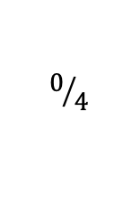
Example
CountPs.dfy
  Call chains
$$0/4$$
function P(x: int): bool
//...
// Count the number of values less than "n" that satisfy "P"
function CountPs(n: nat): int
{
if n == 0 then
0
else if P(n - 1) then
1 + CountPs(n - 1)
else
CountPs(n - 1)
}
Lecture 3

Slide 60
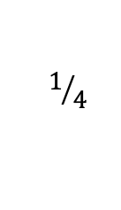
Example
CountPs.dfy
  Call chains
$$1/4$$
function P(x: int): bool
//...
// Count the number of values less than "n" that satisfy "P"
function CountPs(n: nat): int
decreases n, 1
{
if n == 0 then
0
else if P(n - 1) then
AddAndCountTheRest(n, 1)
else
AddAndCountTheRest(n, 0)
}
function AddAndCountTheRest(n: nat, x: int): int
requires n != 0
decreases n, 0
{
x + CountPs(n - 1)
}

Slide 61
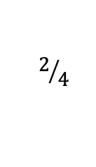
Example
CountPs.dfy
  Call chains
$$2/4$$
function P(x: int): bool
//...
// Count the number of values less than "n" that satisfy "P"
function CountPs(n: nat): int
decreases n
{
if n == 0 then
0
else if P(n - 1) then
AddAndCountTheRest(n, 1)
else
AddAndCountTheRest(n, 0)
}
function AddAndCountTheRest(n: nat, x: int): int
requires n != 0
decreases n, x
{
x + CountPs(n - 1)
}

Slide 62
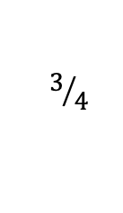
Example
CountPs.dfy
  Call chains
$$3/4$$
function P(x: int): bool
//...
// Count the number of values less than "n" that satisfy "P"
function CountPs(n: nat): int
{
if n == 0 then
0
else if P(n - 1) then
AddAndCountTheRest(n, 1)
else
AddAndCountTheRest(n, 0)
}
function AddAndCountTheRest(n: nat, x: int): int
requires n != 0
{
x + CountPs(n - 1)
}

Slide 63
Example
Mult.dfy
lemma {:induction false} MultCommutative(x: nat, y: nat)
ensures Mult(x, y) == Mult(y, x)
decreases x, y
{
if x == y {
} else if x == 0 {
assert Mult(x, y) == Mult(x, y - 1);
assert Mult(y, x) == 0 == Mult(y - 1, x);
MultCommutative(x, y - 1);
} else if y < x {
MultCommutative(y, x);
} else {
calc {
Mult(x, y);
== // def. Mult
x + Mult(x, y - 1);
== { MultCommutative(x, y - 1); }
x + Mult(y - 1, x);
== // def. Mult
x + y - 1 + Mult(y - 1, x - 1);
== { MultCommutative(x - 1, y - 1); }
x + y - 1 + Mult(x - 1, y - 1);
== // def. Mult
y + Mult(x - 1, y);
== { MultCommutative(x - 1, y); }
y + Mult(y, x - 1);
== // def. Mult
Mult(y, x);
}
}
}
function Mult(x: nat, y: nat): nat {
if y == 0 then 0 else x + Mult(x, y - 1)
}
How cool is this step?
Yep, pretty cool, alright!
Here’s another interesting step. Notice how the arguments are reversed in the recursive call (that is, to call to the induction hypothesis).

Slide 64
Drop
Drop.dfy
$$0/2$$
datatype List<X> = Nil | Cons(head: X, tail: List<X>)
function Length(xs: List): nat {
if xs == Nil then 0 else 1 + Length(xs.tail)
}
function Drop(xs: List, n: nat): List
requires n <= Length(xs)
{
if n == 0 then xs else Drop(xs.tail, n - 1)
}
function Drop'(xs: List, n: nat): (r: List)
requires n <= Length(xs)
ensures Length(r) == Length(xs) - n
{
if n == 0 then xs else Drop'(xs, n - 1).tail
}
lemma {:induction false} Same(xs: List, n: nat)
requires n <= Length(xs)
ensures Drop(xs, n) == Drop'(xs, n)
Lecture 4 (lab)

Slide 65
Drop: solution
Drop.dfy
  Notice the 3 different uses of the inductive hypothesis
$$1/2$$
lemma {:induction false} Same(xs: List, n: nat)
requires n <= Length(xs)
ensures Drop(xs, n) == Drop'(xs, n)
{
if n < 2 {
// easy
} else {
calc {
Drop(xs, n);
== // def. Drop
Drop(xs.tail, n - 1);
== { Same(xs.tail, n - 1); } // I.H.
Drop'(xs.tail, n - 1);
== // def. Drop'
Drop'(xs.tail, n - 2).tail;
== { Same(xs.tail, n - 2); } // I.H.
Drop(xs.tail, n - 2).tail;
== // def. Drop
Drop(xs, n - 1).tail;
== { Same(xs, n - 1); } // I.H.
Drop'(xs, n - 1).tail;
== // def. Drop'
Drop'(xs, n);
}
}
}

Slide 66
Layering methods/functions
Given
function Fib(n: nat): nat
decreases n
{
if n < 2 then n else Fib(n-2) + Fib(n-1)
}
Specify termination of
function SumOfFibs(xs: List<nat>): nat
decreases ??
{
if xs == Nil then 0 else
Fib(xs.head) + SumOfFibs(xs.tail)
}

Slide 67
Layering methods/functions
One possibility:
function Fib(n: nat): nat
decreases 0, n
{
if n < 2 then n else Fib(n-2) + Fib(n-1)
}
function SumOfFibs(xs: List<nat>): nat
decreases 1, xs
{
if xs == Nil then 0 else
Fib(xs.head) + SumOfFibs(xs.tail)
}
But this requires changing the given specification of Fib 😟

Slide 68
Call graph
F
Gold
H
J
G
K
Cumquat
Emerald
SumOfFibs
Gold ≻ Cumquat
Gold ≻ Emerald
Emerald ≻ Rose
Rose ≻ Cyan
Rose
Fib
Cyan

Slide 69
Termination metrics in Dafny
(updated)
Dafny fixes a well-founded order for each type
Its termination metrics use
𝒞 × 𝒜⊤ × 𝒜⊤ × ⋯ × 𝒜⊤
where
  𝒜 is the union of all types
  𝒞 is the set of strongest connected components (SCCs) of the call graph
  k is the length of the longest given decreases clause in the program
decreases clauses are automatically padded to the longest length
k

Slide 70
Layering methods/functions
Solution
function Fib(n: nat): nat
decreases n
{
if n < 2 then n else Fib(n-2) + Fib(n-1)
}
function SumOfFibs(xs: List<nat>): nat
decreases xs
{
if xs == Nil then 0 else
Fib(xs.head) + SumOfFibs(xs.tail)
}

Slide 71
Datatype examples
AST.dfy
  Mutual recursion, mutual induction
$$0/2$$
datatype List<X> = Nil | Cons(head: X, tail: List<X>)
datatype Expr =
| Const(c: int)
| Var(name: string)
| Node(op: Operator, args: List<Expr>)
type Operator
function Subst(e: Expr, name: string, x: int): Expr
{
match e
case Const(_) => e
case Var(n) => if n == name then Const(x) else e
case Node(op, args) => Node(op, SubstList(args, name, x))
}
function SubstList(es: List<Expr>, name: string, x: int): List<Expr>
{
match es
case Nil => Nil
case Cons(e, tail) => Cons(Subst(e, name, x), SubstList(tail, name, x))
}
lemma SubstIdempotent(e: Expr, name: string, x: int)
ensures Subst(Subst(e, name, x), name, x) == Subst(e, name, x)

Slide 72
Datatype examples
AST.dfy
  Mutual recursion, mutual induction
$$1/2$$
lemma SubstIdempotent(e: Expr, name: string, x: int)
ensures Subst(Subst(e, name, x), name, x) == Subst(e, name, x)
{
match e
case Const(_) =>
case Var(_) =>
case Node(op, args) =>
SubstListIdempotent(args, name, x);
}
lemma SubstListIdempotent(es: List<Expr>, v: string, c: int)
ensures SubstList(SubstList(es, v, c), v, c) == SubstList(es, v, c)
{
match es
case Nil =>
case Cons(e, tail) =>
calc {
SubstList(SubstList(es, v, c), v, c);
== // def. inner SubstList
SubstList(Cons(Subst(e, v, c), SubstList(tail, v, c)), v, c);
== // def. outer SubstList
Cons(Subst(Subst(e, v, c), v, c), SubstList(SubstList(tail, v, c), v, c));
== { SubstIdempotent(e, v, c); }
Cons(Subst(e, v, c), SubstList(SubstList(tail, v, c), v, c));
== { SubstListIdempotent(tail, v, c); }
Cons(Subst(e, v, c), SubstList(tail, v, c));
== // def. SubstList
SubstList(es, v, c);
}
}

Slide 73
Generating finite lists
Streams.dfy
datatype List<X> = Nil | Cons(head: X, tail: List<X>)
function Generate(lo: int, hi: int): List<int>
requires lo <= hi
decreases hi - lo
{
if lo == hi then Nil else Cons(lo, Generate(lo + 1, hi))
}
predicate AllPositive(xs: List<int>) {
match xs
case Nil =>
true
case Cons(x, tail) =>
1 <= x && AllPositive(tail)
}
lemma {:induction false} GenerateGivesAllPositive(lo: int, hi: int)
requires 1 <= lo <= hi
ensures AllPositive(Generate(lo, hi))
decreases hi - lo
{
var xs := Generate(lo, hi);
match xs
case Nil =>
case Cons(_, tail) =>
assert tail == Generate(lo + 1, hi);
GenerateGivesAllPositive(lo + 1, hi);
}

Slide 74
Generating infinite lists
Streams.dfy
codatatype IList<X> = Cons(head: X, tail: IList<X>)
function Generate(lo: int): IList<int> {
Cons(lo, Generate(lo + 1))
}
predicate AllPositive(xs: IList<int>) {
1 <= xs.head && AllPositive(xs.tail)
}
lemma {:induction false} GenerateGivesAllPositive(lo: int)
requires 1 <= lo
ensures AllPositive(Generate(lo))
{
var xs := Generate(lo);
assert xs.tail == Generate(lo + 1);
GenerateGivesAllPositive(lo + 1);
}
Co-recursive call
Cannot prove termination

Slide 75

The recurrence equation
$$AllPositive = ℱ(AllPositive)$$
has many solutions in $AllPositive$
We want the greatest solution

Slide 76
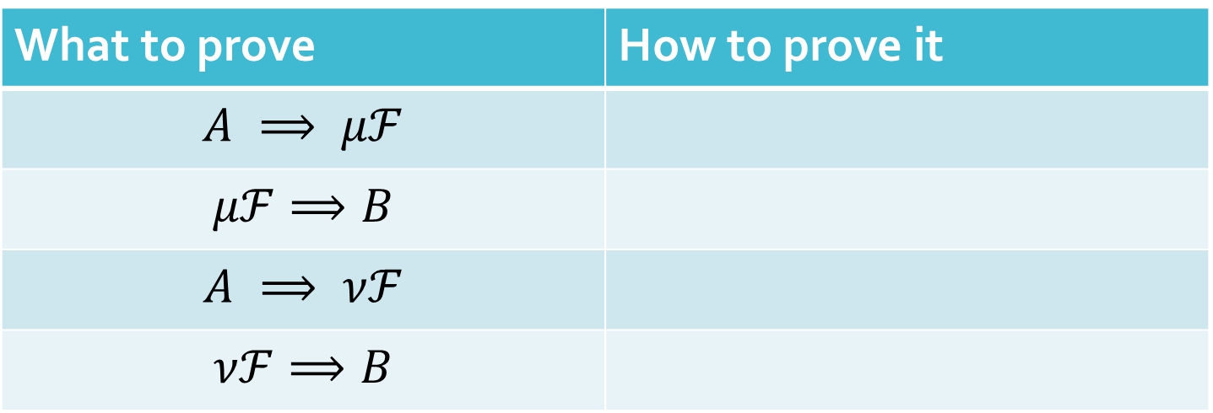


Proofs
$$P = ℱ(P)$$
With
For $P= ℱ\left(P\right)$,
What to prove | How to prove it
$$A ⟹ μℱ$$
$$μℱ⟹B$$
$$A ⟹ νℱ$$
$$νℱ⟹B$$

Slide 77
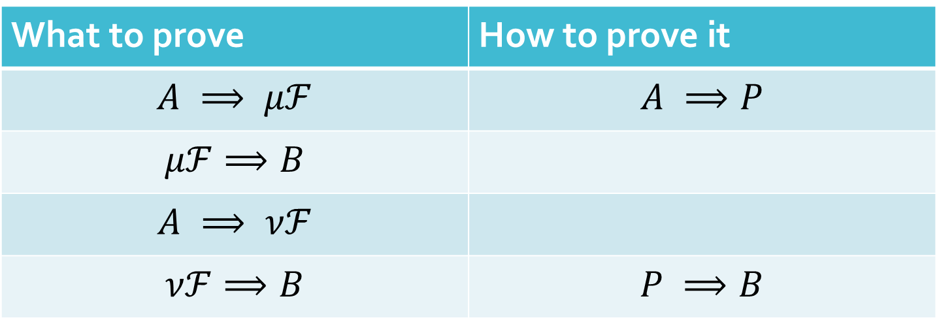
Proofs
$$P = ℱ(P)$$
With
For $P= ℱ\left(P\right)$,
What to prove | How to prove it
$$A ⟹ μℱ$$ | $$A ⟹P$$
$$μℱ⟹B$$
$$A ⟹ νℱ$$
$$νℱ⟹B$$ | $$P ⟹B$$

Slide 78
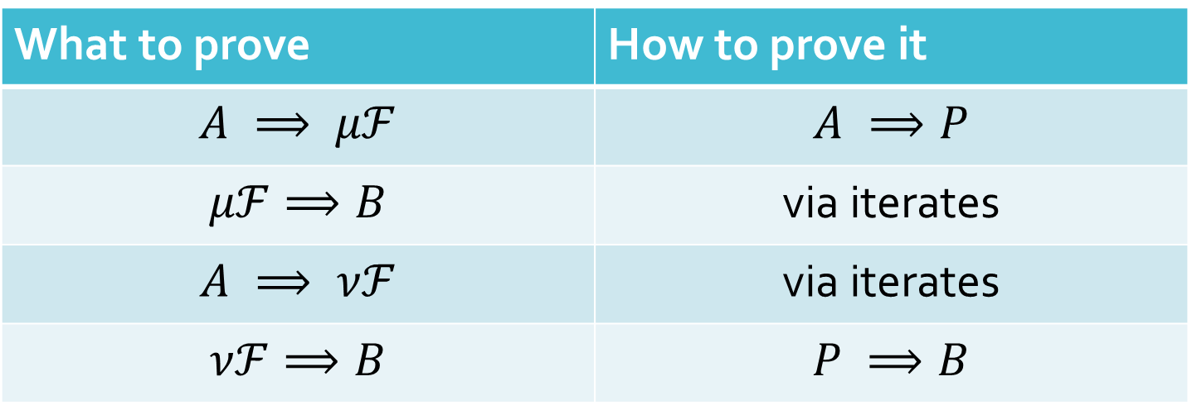
Proofs
$$P = ℱ(P)$$
With
For $P= ℱ\left(P\right)$,
What to prove | How to prove it
$$A ⟹ μℱ$$ | $$A ⟹P$$
$$μℱ⟹B$$ | via iterates
$$A ⟹ νℱ$$ | via iterates
$$νℱ⟹B$$ | $$P ⟹B$$

Slide 79
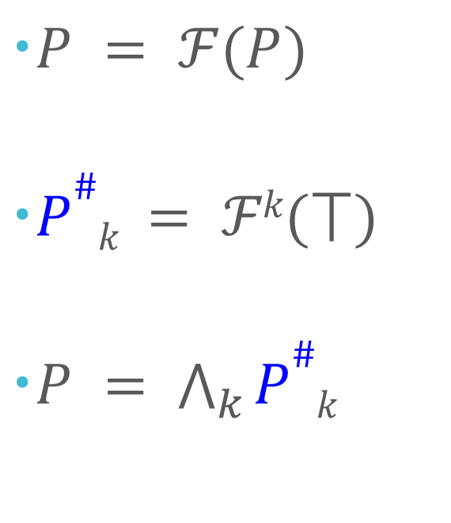
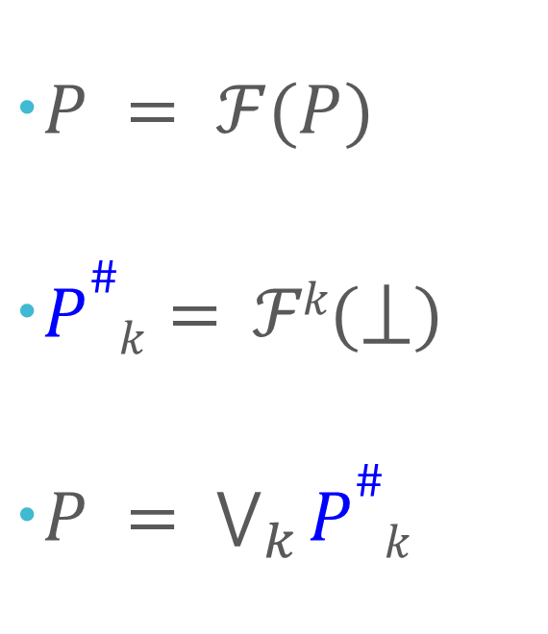

Iterates
Least solution
Greatest solution
$P = ℱ(P)$
$P\#k= ℱk\text{(}⟘\text{)}$
$P = \bigvee_{k}{P\#k}$
$P = ℱ(P)$
$P\#k = ℱk\text{(}⟙\text{)}$
$P = \bigwedge_{k}{P\#k}$
provided $ℱ$ is continuous

Slide 80

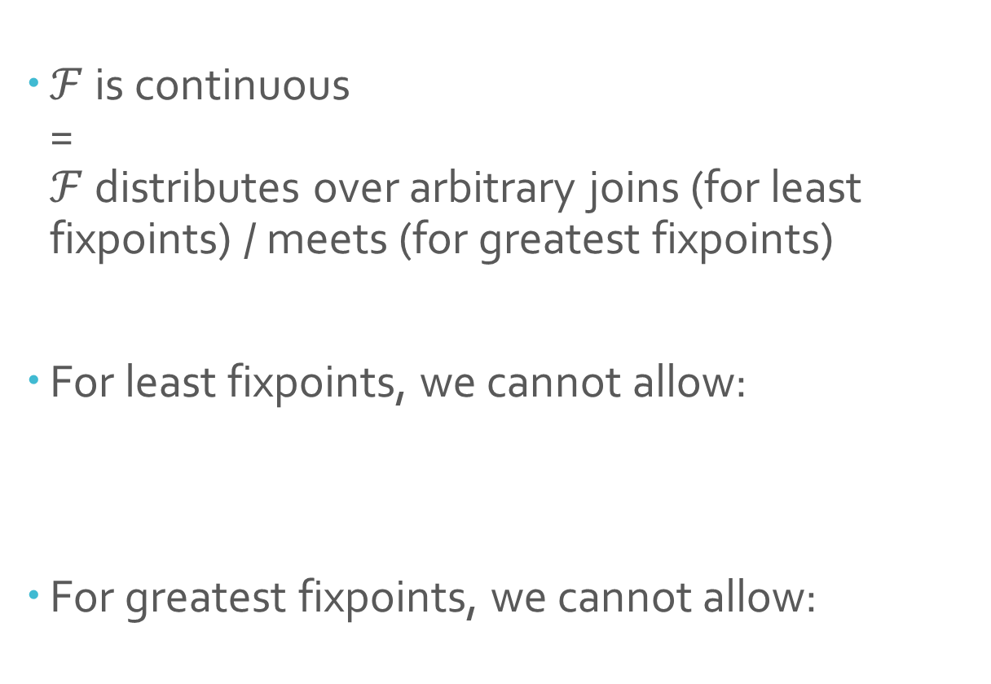

Continuity
$ℱ$ is continuous
=
$ℱ$ distributes over arbitrary joins (for least fixpoints) / meets (for greatest fixpoints)
For least fixpoints, we cannot allow:
For greatest fixpoints, we cannot allow:
$$P = … ∀x∙ …P…$$
$$P = … ∃x∙ …P…$$

Slide 81


Iterates
For least fixpoints: (and dually for greatest fixpoints)
$P\#0 = ⟘$
$P\#i+1 =ℱ\text{(}P\#i\text{)}$
$P\#λ = \bigvee_{o<λ}{ℱo}$
$P = \bigvee_{o}{P\#o}$
regardless of whether $ℱ$ is continuous

Slide 82
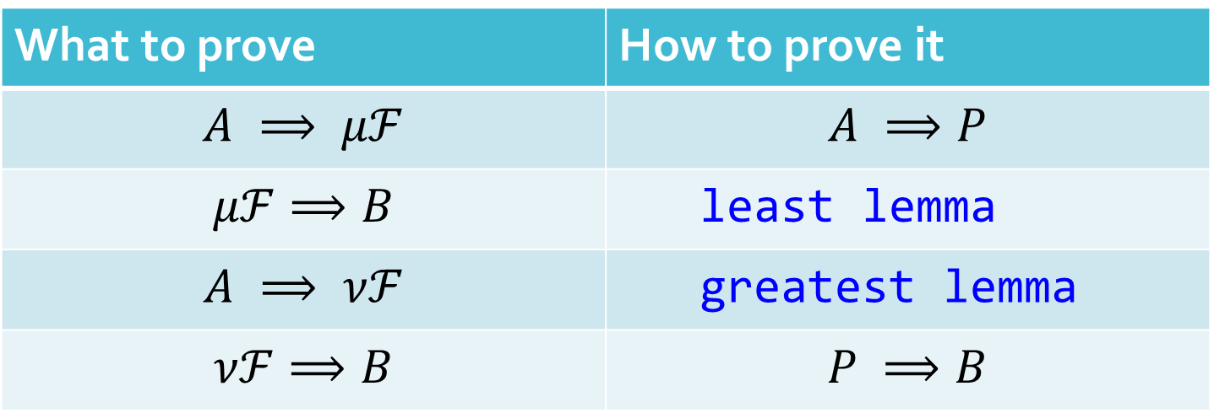
Proofs
$$P = ℱ(P)$$
With
For $P= ℱ\left(P\right)$,
What to prove | How to prove it
$$A ⟹ μℱ$$ | $$A ⟹P$$
$$μℱ⟹B$$ | least lemma
$$A ⟹ νℱ$$ | greatest lemma
$$νℱ⟹B$$ | $$P ⟹B$$

Slide 83
Generating infinite lists
Streams.dfy
codatatype IList<X> = Cons(head: X, tail: IList<X>)
function Generate(lo: int): IList<int> {
Cons(lo, Generate(lo + 1))
}
greatest predicate AllPositive(xs: IList<int>) {
1 <= xs.head && AllPositive(xs.tail)
}
greatest lemma {:induction false} GenerateGivesAllPositive(lo: int)
requires 1 <= lo
ensures AllPositive(Generate(lo))
{
var xs := Generate(lo);
assert xs.tail == Generate(lo + 1);
GenerateGivesAllPositive(lo + 1);
}

Slide 84
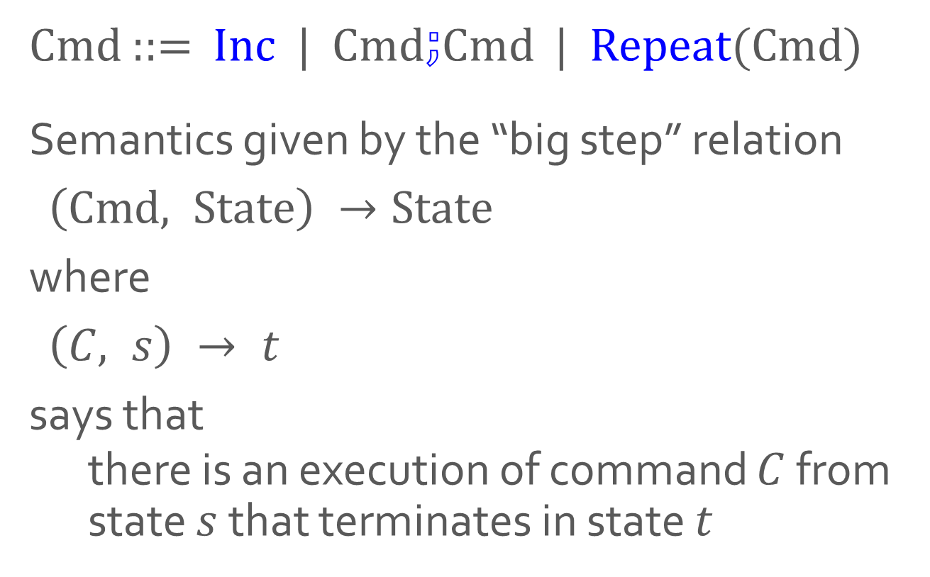
Language illustration: INC
Cmd ::= Inc | Cmd$⨟$Cmd | Repeat(Cmd)
Semantics given by the “big step” relation
$\left(Cmd, State\right) →State$
where
$\left(C, s\right) → t$
says that
  there is an execution of command $C$ from state $s$ that terminates in state $t$

Slide 85
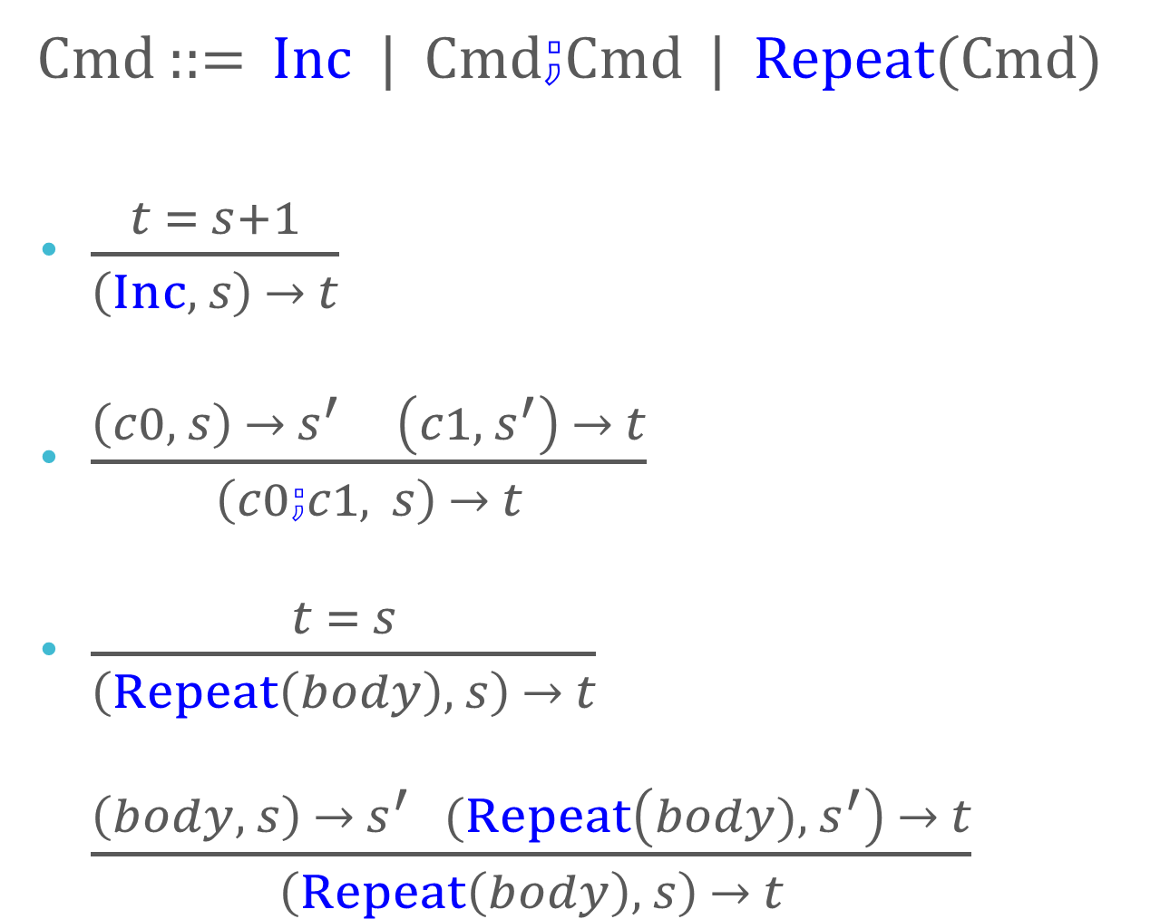
Semantics of INC
Cmd ::= Inc | Cmd$⨟$Cmd | Repeat(Cmd)
$\frac{t = s+1}{\left(Inc, s\right) → t}$
$\frac{\left(c0, s\right) → s^{′} \left(c1,{ s}^{′}\right) → t}{\left(c0⨟c1, s\right) → t}$
$\frac{t = s}{\left(Repeat\left(body\right), s\right) → t}$
$\frac{\left(body, s\right) →{ s}^{′} (Repeat\left(body), { s}^{′}\right) → t}{\left(Repeat\left(body\right), s\right) → t}$

Slide 86
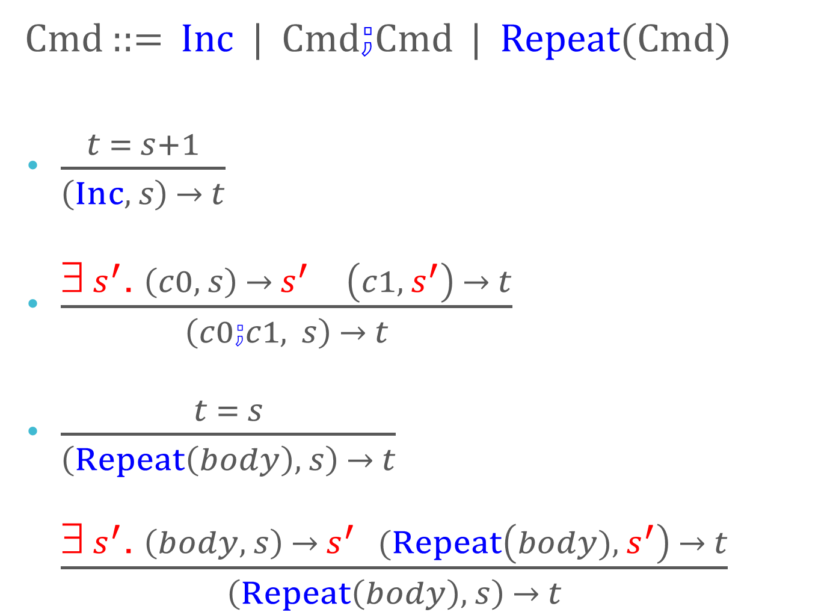
Semantics of INC
Cmd ::= Inc | Cmd$⨟$Cmd | Repeat(Cmd)
$\frac{t = s+1}{\left(Inc, s\right) → t}$
$\frac{\text{∃}{ s}^{′}\text{.} \left(c0, s\right) → s^{′} \left(c1,{ s}^{′}\right) → t}{\left(c0⨟c1, s\right) → t}$
$\frac{t = s}{\left(Repeat\left(body\right), s\right) → t}$
$\frac{\text{∃}{ s}^{′}\text{.} \left(body, s\right) →{ s}^{′} (Repeat\left(body), { s}^{′}\right) → t}{\left(Repeat\left(body\right), s\right) → t}$

Slide 87
Summary
You can call whatever you want whenever you want, provided
  you satisfy the precondition, and
  you can show a decrease in some fixed well-founded order
Examples:
  FastPow: strong induction
  SubstIdempotent: mutual recursion/induction
  x/y: custom ordering
  MultComm: ad-hoc cases
  Call chains: use constants, call-graph SCC
Extreme predicates
  defined as least or greatest fix-points
  recursive calls have to be in positive positions, but need not terminate
  reasoning uses analogous extreme lemmas
Program safely!

