Slide 1
Reflections on automated software verification
K. Rustan M. Leino
23 March 2026
ETH Zurich
Zurich, Switzerland

Slide 2
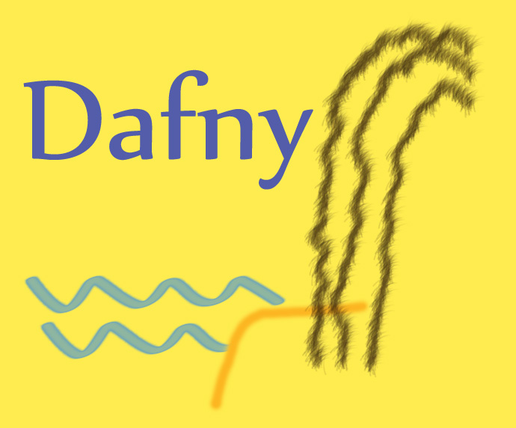
Dafny: language
Dafny (dafny.org)
  18 years old
Programming language
  General purpose
  Designed to support verification
  Designed to be familiar to mainstream developers
Constructs for
  Imperative programming
  Functional programming
  Specifications
  Proofs

Slide 3
Dafny: tooling
Automated deductive verifier
  Built on Boogie, uses SMT
VS Code integration
Cross compilers
AI friendly
  LLMs do well with Dafny

Slide 4
Show and tell
Binary search
Wildcard match

Slide 5
Impact
Industry
Research
Teaching
Community

Slide 6
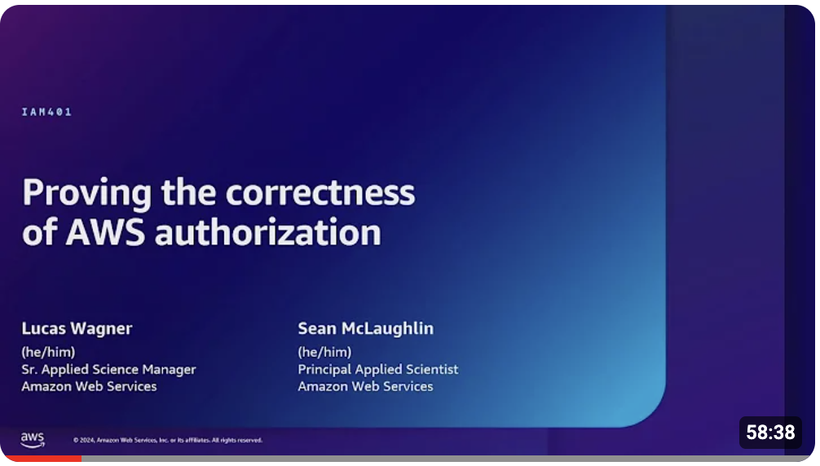
Impact: industry
At AWS
  AWS’s authorization engine
  Paper at ICSE 2025.
  Talk at AWS re:Inforce 2024:
  https://youtu.be/oshxAJGrwMU
  AWS Encryption SDK
  AWS Database Encryption SDK
  …
💡Verification can be done for performant, relevant applications
💡Proofs can be done by software engineers

Slide 7
Impact: research
Ironclad Apps
IronFleet
Vale
Armada
EVM formalization
NFS/Daisy
…
💡Systems researchers can use verification effectively

Slide 8
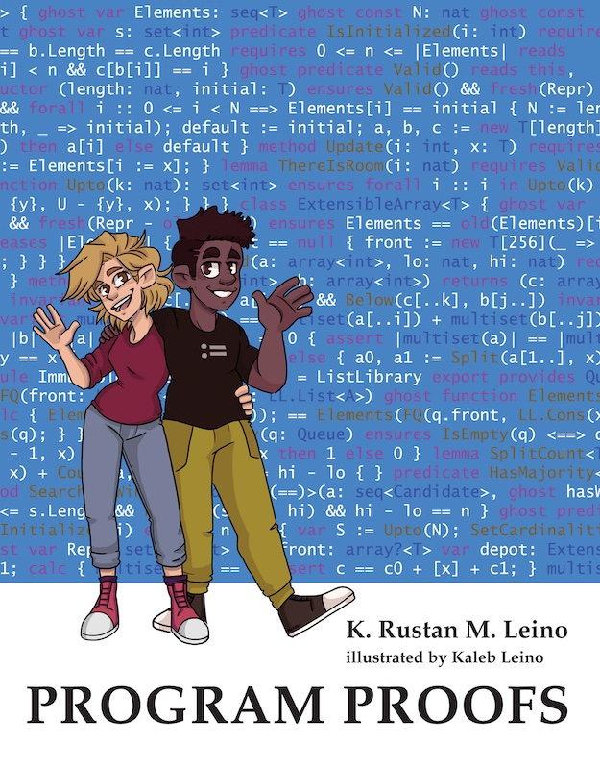
Impact: teaching
15+ years, dozens of universities
  The University of Queensland
  MIT (Spring 2025)
  …
Books
  Program Proofs, KRML (MIT Press, 2023)
  program-proofs.com
  Algoritmos y estructuras de datos: Con programas verificados en Dafny, Ricardo Peña Marí (Ibergarceta Publicaciones, 2019)
💡A language designed for verification does well in teaching

Slide 9
Impact: community
Dafny workshop
  2024, 2025, 2026
  co-located with POPL
  for Dafny and Dafny-style languages/verifiers
Appetite for verifiers of mainstream languages
  Verus (Rust)
  Viper-based tools (Rust, Go, Python)
  Stainless (Scala)
  SPARK toolset (Ada)
  …
LLM ❤️ Dafny
  1000’s of problems in A benchmark for vericoding: formally verified program synthesis, Bursuc et al., 2025
    Dafny, 82%
    Verus, 44%
    Lean, 27%
  (the similar language/verifier F* also does well with LLMs)
  …
💡Verification is becoming popular

Slide 10
Evolving from origins
Immediate predecessors: ESC/Java … Spec# …
Original motivation: new specifications of object data structures
  No subclassing
  No built-in invariant for objects
  Modest need for language support
    modifies/reads frames, sets, ghost variables
No existing libraries, build systems, users
Any new user is already interested in verification!
💡

Slide 11
Dafny logic
Higher-order, partial, classical logic with empty types
Expressions are deterministic
  User experience phases:
  obvious → subtle → questioning → at ease
Expressions (and statements) are partial
  Proof obligations for well-definedness 😊
  Well-definedness properties “linger” in verifier 🤔

Slide 12
Dafny logic: references
new yields a reference to a previously unreachable object
method M(c: C) {
var d := new C;
assert c != d;
}
function P(): bool {
forall c: C :: c.x == 10
}
💡New-object allocation is important and tricky

Slide 13
Types
class Point {
var x: int
var y: int
}
datatype List =
| Nil
| Cons(head: int, tail: List)
Mutable fields
Identity
Reference equality
Immutable
Structural equality
💡A language does well to provide both of these directly

Slide 14
Types: members
class Point {
var x: int
var y: int
function Sum(): int { … }
}
datatype List =
| Nil
| Cons(head: int, tail: List)
{
function Sum(): int { …}
}

Slide 15
Types: traits (original)
trait Summable {
function Sum(): int
}
class Point extends Summable {
var x: int
var y: int
function Sum(): int { … }
}
datatype List =
| Nil
| Cons(head: int, tail: List)
{
function Sum(): int { …}
}

Slide 16
Types: traits (general)
trait Summable {
function Sum(): int
}
class Point extends Summable {
var x: int
var y: int
function Sum(): int { … }
}
datatype List extends Summable =
| Nil
| Cons(head: int, tail: List)
{
function Sum(): int { …}
}
💡Design the language to treat types equally, not being biased for either kind of type

Slide 17
Subset types
(aka refinement types)
(aka constrained types)
(aka predicate subtypes)
type nat = x: int | 0 <= x
var i: int
var n: nat
…
i := n;
…
n := i;
Type inference is difficult
but essential, and cannot rely on first assignment
forall i, j :: 0 <= i < j < a.Length ==> a[i] <= a[j]
forall i: int, j: int :: 0 <= i < j < a.Length ==> a[i] <= a[j]
✅
✅ Checked by verifier
💡Subset types are important, but I’m wishing for better understood type inference

Slide 18
Nullable vs non-null reference types
class Point { … }
gives rise to two types:
  nullable reference type Point?
  subset type
  type Point = p: Point? | p != null
Complicates type inference with reference traits
  Summable? :> Summable :> Point
  Summable? :> Point? :> Point
A union type would be better, perhaps like
  type Point? = Point | {null}
💡

Slide 19
Uniform treatment of ghost code
Variables, methods, functions, statements, expressions can be either
  compiled or
  ghost (used by the verifier, erased by the compiler)
Ghosts can be used in unexpected ways:
  Write specifications
  Allow expressions that cannot be compiled
  Define and prove lemmas
  Call lemmas from compiled code
  Tail recursion modulo ghosts
  Specify and implement uninitialized storage
  …
💡All languages ought to support ghost code

Slide 20
Termination
Once a skeptic, I am now a believer
Part of well-formedness checks
Prevents unsoundness of logic
  Ghost code must always terminate
  Prevents inconsistent function definitions
Fixed well-founded order
Default decreases clauses
💡Termination specifications/checks are easy and
are good to support

Slide 21
Termination: fixed well-founded order
💡
Dafny fixes a well-founded order for each type, e.g.
Its termination metrics use
𝒞 × 𝒜⊤ × 𝒜⊤ × ⋯ × 𝒜⊤
where
  𝒜 is the union of all types
  𝒞 is the set of strongest connected components (SCCs) of the call graph
  k is the length of the longest given decreases clause in the program
decreases clauses are automatically ⊤-padded to the longest length
type | X ≻ y
int | 0 ≤ X ⋀ y < X
bool | X ⋀ ¬y
inductive datatypes | X structurally includes y
set<T> | y ⊊ X
iset<T> | false
Example:
decreases hi - lo, a[lo]
💡
k
💡

Slide 22
Termination: default decreases clauses
method M(x: X, y: Y, z: Z)
decreases x, y, z
while a < b
decreases b - a
💡default
💡default

Slide 23
Compiler(s)
Dafny supports full compilation to 5 target platforms:
  .NET
  JVM
  JavaScript
  Go
  Python
Piggybacks on runtime systems of target platforms (garbage collector, …)
Attracts users
Burden to support
Compilation is just part of the story – also need scaffolding
Non-idiomatic target code
Would do better with flagship compiler
💡

Slide 24
Foreign function interface
(FFI)
Supported
  newtype int32 = x: int |
  -0x8000_0000 <= x < 0x8000_0000
  {:extern}
but easy for users to make mistakes
  method Move(pt: Point)
  ensures pt.x == old(pt.x) + 1
  method Get() returns (pt: Point)
  method Write(stream: IO, txt: string)
  modifies stream
  function Random(n: nat): (r: nat)
  requires 1 <= n
  ensures 0 <= r < n
💡Need better checks for FFI specifications

Slide 25
Verifier performance
Often nearly instant
Quick turnaround is crucial
Automation uses
  Automatic function unfolding, fuel, literal wrapping, can-call certificates, automatic induction, …
Stability is important
SMT community has not paid enough attention to deductive verification
  Failing quickly is as important as succeeding quickly
  Quantifier support
💡
💡

Slide 26
Verification stability: example
Suppose the verifier knows how to use A to prove C, provided the context mentions X
method M()
requires A
{
if B {
… mentions X …
} else {
…
}
assert C;
}
In this branch, the verifier learns the lemma
A ==> C
💡Clause learning needs to take “matching patterns” into account

Slide 27
Conclusions
A full general-purpose programming language can be designed with powerful verification support
Verifiers are being built for mainstream languages
AI helps the case for verification
Hope to see more verification influence on programming languages in the future
💡
Program safely!

