Slide 1
The use and anatomy of an auto-active verifier
K. Rustan M. Leino
30 June – 3 July 2026
OPLSS 2026
Eugene, OR, USA

Slide 2
Auto-matic inter-active
Program
method M(x: int)
requires 0 ≤ x
ensures Q(x)
{
var n := 0;
while n < x
invariant Q(n)
{
…
}
}
generates
Logical formula
∀ x • 0 ≤ x ⇒
… ⇒ Q(x)
User interaction happens here
Lecture 0

Slide 3
Auto-matic inter-active
Programs
Specifications
Program
method M(x: int)
requires 0 ≤ x
ensures Q(x)
{
var n := 0;
while n < x
invariant Q(n)
{
…
}
}
Proofs
User interaction happens here
In auto-active verification, user interaction happens at the source
generates
Logical formula
∀ x • 0 ≤ x ⇒
… ⇒ Q(x)

Slide 4
Outline
Lecture 0: Small programs and proofs
Lecture 1: Slighly larger programs and proofs
Lecture 2: Implementation of a verifier
Lecture 3: Reflections on language design

Slide 5
Goals of lectures 0 and 1
Teach concepts of program verification
Give you confidence that you can verify programs and write mechanically checked proofs
Show the auto-active interaction style

Slide 6

Dafny: language
Dafny (dafny.org)
Programming language
  General purpose
  Designed to support verification
  (proof-oriented)
  Designed to be familiar to mainstream developers
Constructs for
  Imperative programming
  Functional programming
  Specifications
  Proofs
LLMs do well with Dafny

Slide 7
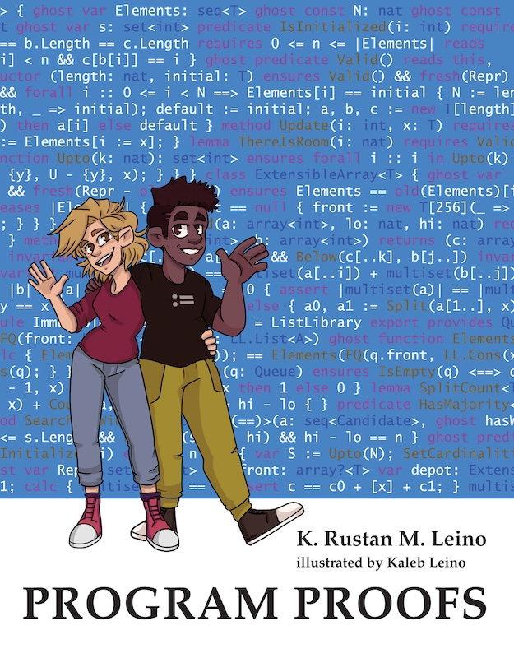
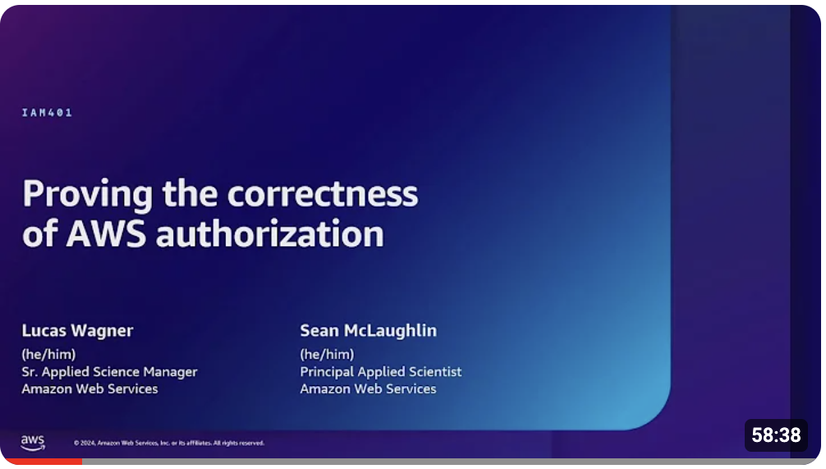
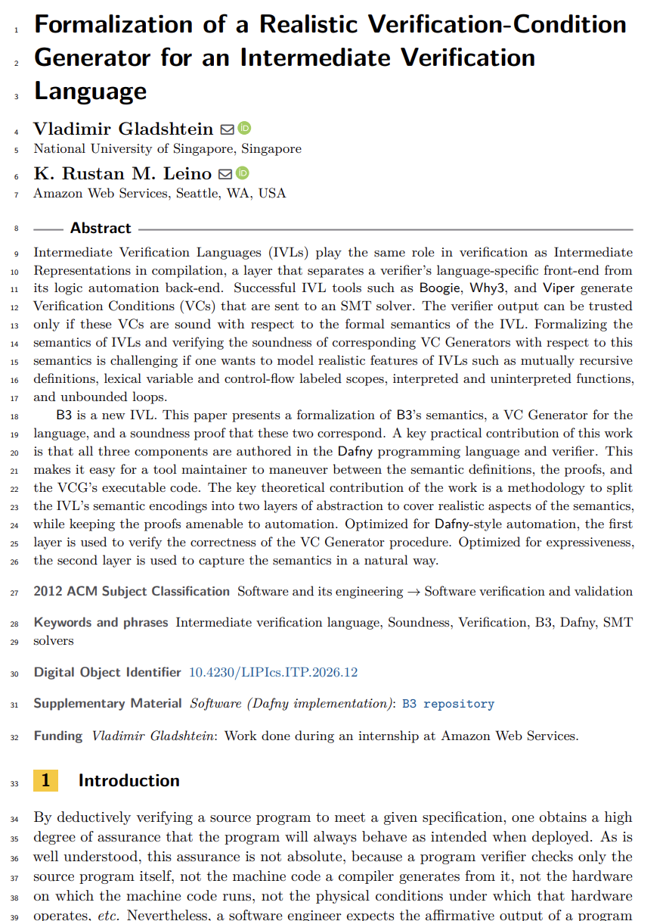
Some uses of Dafny
Teaching
  Over a decade, many universities
Industrial use
  AWS’s authorization engine
  Paper at ICSE 2025.
  Talk at AWS re:Inforce 2024:
  https://youtu.be/oshxAJGrwMU
Research projects
  Ironclad Apps, IronFleet, Armada, Vale, …
  Meta theory
ITP 2026

Slide 8
Programs
Double
Min
Sums
BoolSort

Slide 9
“What remains to be done” invariants
function Sum(s: seq<int>): int {
if |s| == 0 then 0 else s[0] + Sum(s[1..])
}
method ComputeSum(s: seq<int>) returns (r: int)
ensures r == Sum(s)
{
r := 0;
var i := 0;
while i < |s|
invariant 0 <= i <= |s|
invariant r == Sum(s[..i])
invariant Sum(s) == r + Sum(s[i..])
{
r, i := r + s[i], i + 1;
}
}

Slide 10
Sort with boolean keys: solution (variation 0)
method BoolSort(a: array<Data>)
modifies a
ensures forall i, j :: 0 <= i < j < a.Length ==> !a[i].key || a[j].key
{
var lo, hi := 0, a.Length;
while lo != hi
invariant 0 <= lo <= hi <= a.Length
invariant forall i :: 0 <= i < lo ==> !a[i].key
invariant forall i :: hi <= i < a.Length ==> a[i].key
// decreases hi - lo
{
if !a[lo].key {
lo := lo + 1;
} else if a[hi - 1].key {
hi := hi - 1;
} else {
a[lo], a[hi - 1] := a[hi - 1], a[lo];
lo := lo + 1;
hi := hi - 1;
}
}
}

Slide 11
Sort with boolean keys: solution (variation 1)
method BoolSort(a: array<Data>)
modifies a
ensures forall i, j :: 0 <= i < j < a.Length ==> !a[i].key || a[j].key
{
var lo, hi := 0, a.Length;
while lo != hi
invariant 0 <= lo <= hi <= a.Length
invariant forall i :: 0 <= i < lo ==> !a[i].key
invariant forall i :: hi <= i < a.Length ==> a[i].key
decreases hi - lo, lo < a.Length && a[lo].key
{
if !a[lo].key {
lo := lo + 1;
} else if a[hi - 1].key {
hi := hi - 1;
} else {
a[lo], a[hi - 1] := a[hi - 1], a[lo];
}
}
}

Slide 12
Sort with boolean keys: solution (variation 2)
method BoolSort(a: array<Data>)
modifies a
ensures forall i, j :: 0 <= i < j < a.Length ==> !a[i].key || a[j].key
{
if a.Length <= 1 {
return;
}
var lo, hi := 0, a.Length;
while lo + 1 != hi
invariant 0 <= lo < hi <= a.Length
invariant forall i :: 0 <= i < lo ==> !a[i].key
invariant forall i :: hi <= i < a.Length ==> a[i].key
decreases hi - lo, a[lo].key
{
if !a[lo].key {
lo := lo + 1;
} else if a[hi - 1].key {
hi := hi - 1;
} else {
a[lo], a[hi - 1] := a[hi - 1], a[lo];
}
}
}

Slide 13
Methods vs functions
method M(x: int) returns (y: int) {
<statements>
}
Can mutate state
Can be nondeterministic
Opaque (reasoning uses specification, never the body)
function F(x: int): int {
<expr>
}
Cannot mutate state
Deterministic
Transparent (reasoning uses body) – default,
or opaque

Slide 14
Statements vs expressions
statement | expression
if G { <statements> } else { <statements> } | if G then <expr> else <expr>
match E case Nil => <statements> case Cons(x, tail) => <statements> | match E case Nil => <expr> case Cons(x, tail) => <expr>
optional

Slide 15
Programs
BruteSort
Gauss
Lists
Lecture 1

Slide 16
BruteSort
(0/2)
method BruteSort(a: array<bool>)
modifies a
ensures forall i, j :: 0 <= i < j < a.Length ==> a[i] ==> a[j]
ensures multiset(a[..]) == multiset(old(a[..]))
{
var c0 := 0;
ghost var c1 := 0;
ghost var m := multiset{};
var n := 0;
while n < a.Length
invariant 0 <= n <= a.Length
invariant m == multiset(a[..n])
invariant c0 == m[false] && c1 == m[true]
invariant c0 + c1 == n
{
var x := a[n];
if x {
c1 := c1 + 1;
} else {
c0 := c0 + 1;
}
m := m + multiset{x};
n := n + 1;
}
assert a[..] == a[..n];
⋮

Slide 17
BruteSort
(1/2)
⋮
n := 0;
while n < a.Length
invariant 0 <= n <= a.Length
invariant forall i, j :: 0 <= i < j < n ==> a[i] ==> a[j]
invariant c0 != 0 ==> forall i :: 0 <= i < n ==> !a[i]
invariant multiset(old(a[..])) == m + multiset(a[..n])
invariant c0 == m[false] && c1 == m[true]
invariant c0 + c1 + n == a.Length
{
var x := c0 == 0;
if x {
c1 := c1 - 1;
} else {
c0 := c0 - 1;
}
m := m - multiset{x};
a[n] := x;
n := n + 1;
}
assert a[..] == a[..n];
}

Slide 18
Methods and lemmas
method Gauss(n: nat) returns (t: nat)
ensures t == TriangleSum(n)
{
t := 0;
var i := 0;
while i < n
invariant 0 <= i <= n
invariant t == TriangleSum(i)
{
i := i + 1;
t := t + i;
}
}

Slide 19
Methods and lemmas
method Gauss(n: nat) returns (t: nat)
ensures t == TriangleSum(n)
ensures t == n * (n + 1) / 2
{
t := 0;
var i := 0;
while i < n
invariant 0 <= i <= n
invariant t == TriangleSum(i)
invariant t == i * (i + 1) / 2
{
i := i + 1;
t := t + i;
}
}

Slide 20
Methods and lemmas
method Gauss(n: nat) returns (t: nat)
ensures t == TriangleSum(n)
ensures TriangleSum(n) == n * (n + 1) / 2
{
t := 0;
var i := 0;
while i < n
invariant 0 <= i <= n
invariant t == TriangleSum(i)
invariant TriangleSum(i) == i * (i + 1) / 2
{
i := i + 1;
t := t + i;
}
}

Slide 21
Methods and lemmas
method Gauss(n: nat)
ensures TriangleSum(n) == n * (n + 1) / 2
{
var i := 0;
while i < n
invariant 0 <= i <= n
invariant TriangleSum(i) == i * (i + 1) / 2
{
i := i + 1;
}
}

Slide 22
Methods and lemmas
lemma Gauss(n: nat)
ensures TriangleSum(n) == n * (n + 1) / 2
{
var i := 0;
while i < n
invariant 0 <= i <= n
invariant TriangleSum(i) == i * (i + 1) / 2
{
i := i + 1;
}
}

Slide 23
lemma
≈ method
Stating and proving a lemma is just another application of program logic
(Note: not based on Curry-Howard correspondence)
For both methods and lemmas, you have to establish the postcondition for every input and every control path
Calling a method/lemma obtains the information from its postcondition (and, for methods, experiences any side effects)
Methods that call themselves are known as recursive
Lemmas that call themselves are known as inductive
These are really the same!

Slide 24
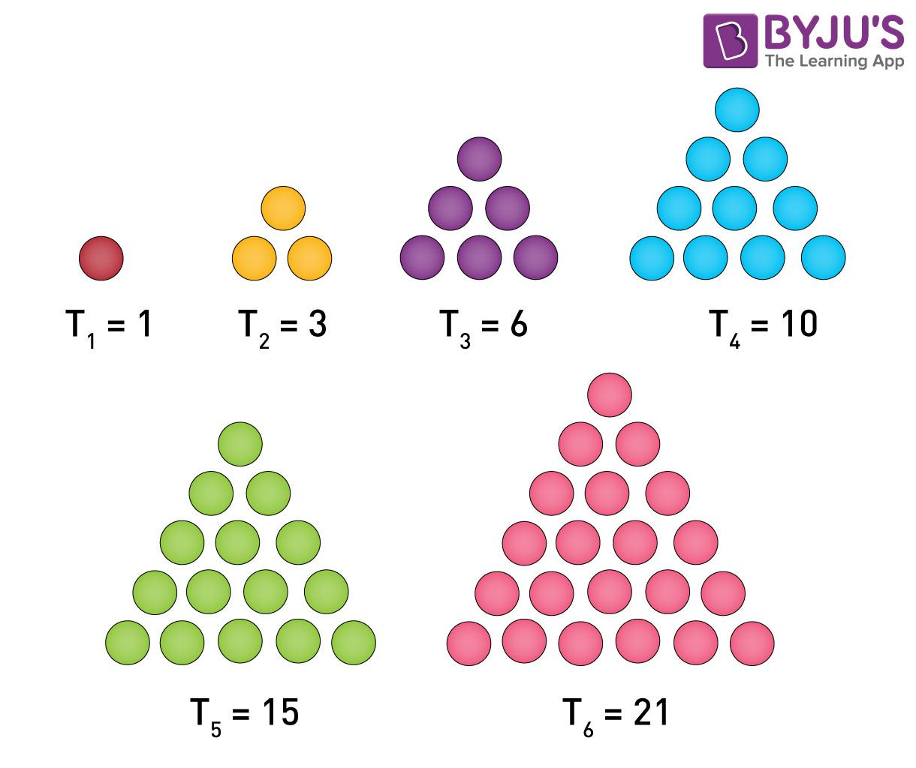
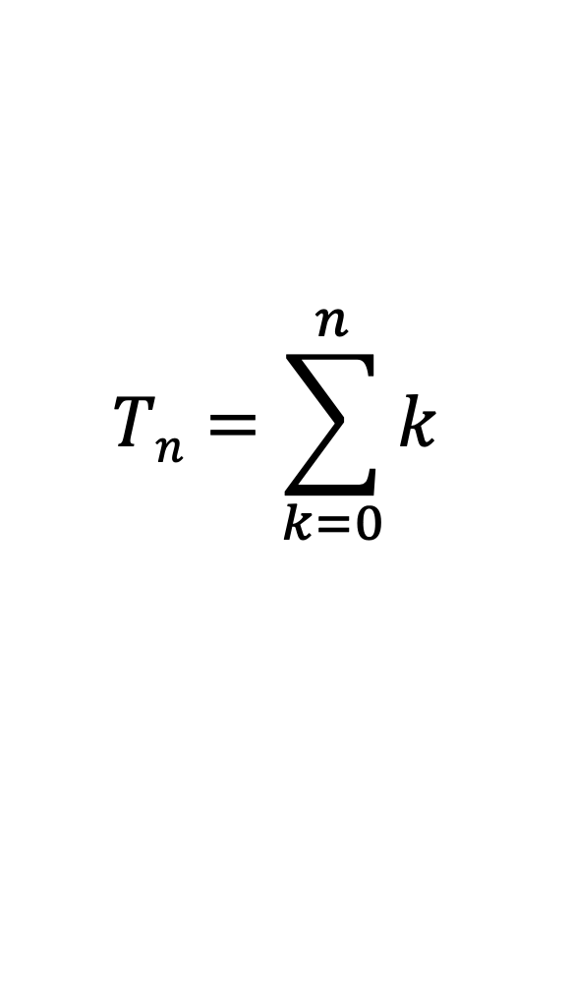
Triangle numbers
function TriangleSum(n: nat): nat {
if n == 0 then 0 else TriangleSum(n – 1) + n
}
$$Tn=\sum_{k=0}^{n}{k}$$
T₀ = 0
Image credit: byjus.com

Slide 25
Homework
Change the second loop in BruteSort to go from a.Length down to 0
Define a datatype Tree and functions Depth and Mirror. Then, prove
  Depth(Mirror(t)) == Depth(t)
  Mirror(Mirror(t)) == t

Slide 26
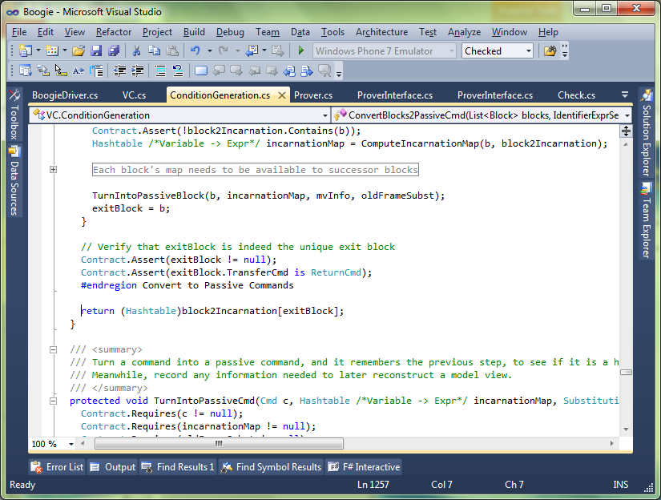

Source
Source
Intermediate representation (IR)
Intermediate verification language (IVL)
Compiler
Verifier
Verification condition (formula)
Machine code
Lecture 2

Slide 27
Intermediate verification languages
(IVLs)
Why3
Boogie
Viper
Coma
B3
…

Slide 28
Verifier architecture
Source program
Translator
IVL program
VC generator
VCs
Logic Engine
Yes (and optionally a proof) or
No (and optionally a counterexample)
IVL = Intermediate Verification Language
VC = Verification Condition

Slide 29
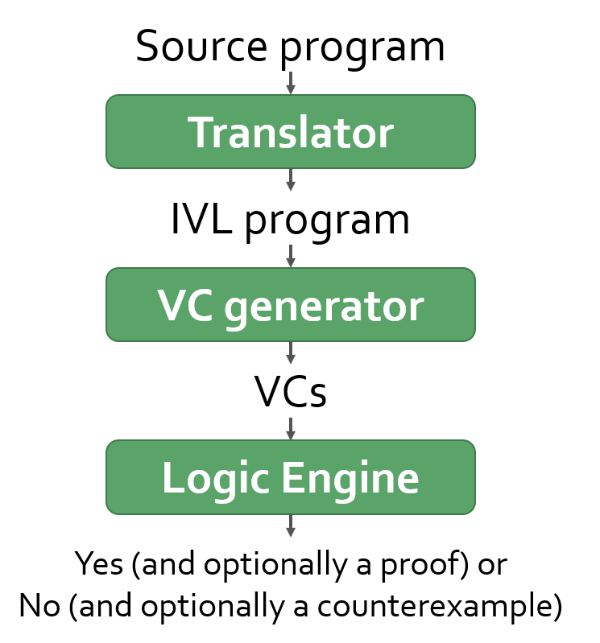
IVL in a nutshell
IVL ::= Axiom* Proc*
Axiom ::= axiom Expr
Proc ::= procedure Id
requires Expr
ensures Expr
{ Stmt }

Slide 30
VC generation in a nutshell
IVL
axiom A0
axiom A1
⋮
procedure M0 requires P0 ensures Q0 { S0 }
procedure M1 requires P1 ensures Q1 { S1 }
⋮
Given
generate
A0 ∧ A1 ∧ … ∧ P0 ⟹ wp⟦ S0, Q0 ⟧
A0 ∧ A1 ∧ … ∧ P1 ⟹ wp⟦ S1, Q1 ⟧
⋮
VC

Slide 31
Demo
Source → IVL → VCs

Slide 32
IVL in more detail
Stmt ::=
| var x := Rhs
| x := Rhs
| assert Expr
| Stmt ; Stmt
| Stmt [] Stmt
| loop
| procedure call
| …
Rhs ::= Expr | *

Slide 33
Weakest preconditions
wp⟦ x := e, Q ⟧ =
Q[x := e]
wp⟦ x := *, Q ⟧ =
∀ x․ Q
wp⟦ assert e, Q ⟧ =
e ∧ Q
wp⟦ S;T, Q ⟧ =
wp⟦ S, wp⟦ T, Q ⟧⟧
wp⟦ S [] T, Q ⟧ =
wp⟦ S, Q ⟧ ∧ wp⟦ T, Q ⟧

Slide 34
Well-formedness (simple)
x := a / b
Source
assert b ≠ 0
x := a / b
IVL

Slide 35
Choice of integer treatments
var a: u32, b: u32, x: u32
…
x := a + b
Source
x := a + b
IVL
x := (a + b) % 0x1_0000_0000
IVL
assert a + b < 0x1_0000_0000
x := a + b
IVL
IVL
if a + b < 0x1_0000_0000 {
x := a + b
} else {
model the throwing of an exception
}

Slide 36
Definite assignment
var x
if B {
x := 100
}
…
if C {
y := x
}
Source
var x := *; var _defined_x := false
if B {
x := 100; _defined_x := true
}
…
if C {
assert _defined_x; y := x
}
IVL

Slide 37
Translating a type into a larger type
datatype Color = Red | Blue | Green
var c: Color
match c
case Red => S0
case Blue => S1
case Green => S2
Source
if c == Red {
S0
} else if !(c == Red) && c == Blue {
S1
} else if !(c == Red) && !(c == Blue) &&
c == Green {
S2
} else {
assert false;
}
IVL

Slide 38
Translating a type into a larger type
datatype Color = Red | Blue | Green
var c: Color
match c
case Red => S0
case Blue => S1
case Green => S2
Source
if c == Red {
S0
} else if c == Blue {
S1
} else if c == Green {
S2
} else {
assert false;
}
IVL
But the source-language semantics guarantees that control never reaches this branch

Slide 39
Translating a type into a larger type
datatype Color = Red | Blue | Green
var c: Color
match c
case Red => S0
case Blue => S1
case Green => S2
Source
if c == Red {
S0
} else if c == Blue {
S1
} else if c == Green {
S2
} else {
assume we never get here
}
IVL
We would rather do this

Slide 40
Translating a type into a larger type
datatype Color = Red | Blue | Green
var c: Color
match c
case Red => S0
case Blue => S1
case Green => S2
Source
if c == Red {
S0
} else if c == Blue {
S1
} else if c == Green {
S2
} else {
assume false;
}
IVL

Slide 41
Translating a type into a larger type
datatype Color = Red | Blue | Green
var c: Color
match c
case Red => S0
case Blue => S1
case Green => S2
Source
assume c == Red; S0
[]
assume c == Blue; S1
[]
assume c == Green; S2
[]
assume false
IVL
It turns out that assume false is the unit element of []

Slide 42
Translating a type into a larger type
datatype Color = Red | Blue | Green
var c: Color
match c
case Red => S0
case Blue => S1
case Green => S2
Source
assume c == Red; S0
[]
assume c == Blue; S1
[]
assume c == Green; S2
IVL

Slide 43
Weakest preconditions: assume
wp⟦ assert e, Q ⟧ =
e ∧ Q
wp⟦ assume e, Q ⟧ =
e ⟹ Q

Slide 44
Desugar call
procedure M(x) returns (y)
requires P
ensures Q
call a := M(b)
IVL
Desugared IVL
{
var x := b
assert P
var y := *
assume Q
a := y
}
Bind formal in-parameter
Check precondition
Effect the procedure’s effect
Assign actual out-parameter

Slide 45
Desugar loop
IVL
Note that this translation also allows break statements in S
while e
invariant J
{
S
}
let x denote the variables
assigned to by S
Desugared IVL
assert J
x := *
assume J
if e {
S
assert J
assume false
}
Check the invariant on entry
Fast forward to an arbitrary loop iteration
Start in on the next iteration
Check invariant is maintained
Stop checking

Slide 46
wp of loop desugaring
wp⟦ assert J; x := *; assume J;
if e { S; assert J; assume false; }, Q ⟧
=
wp⟦ assert J; x := *; assume J,
wp⟦ if e { S; assert J; assume false; }, Q ⟧⟧
=
wp⟦ assert J; x := *; assume J,
(e ⟹ wp⟦ S; assert J; assume false, Q ⟧) ∧
(¬e ⟹ Q) ⟧
=
wp⟦ assert J; x := *; assume J,
(e ⟹ wp⟦ S; assert J, false ⟹ Q ⟧) ∧
(¬e ⟹ Q) ⟧
=
wp⟦ assert J; x := *; assume J,
(e ⟹ wp⟦ S; assert J, true ⟧) ∧
(¬e ⟹ Q) ⟧
=
wp⟦ assert J; x := *; assume J,
(e ⟹ wp⟦ S, J ∧ true ⟧) ∧
(¬e ⟹ Q) ⟧
=
wp⟦ assert J; x := *; assume J,
(e ⟹ wp⟦ S, J ⟧) ∧ (¬e ⟹ Q) ⟧
=
wp⟦ assert J; x := *,
J ⟹ (e ⟹ wp⟦ S, J ⟧) ∧ (¬e ⟹ Q) ⟧
=
wp⟦ assert J,
∀ x․ J ⟹ (e ⟹ wp⟦ S, J ⟧) ∧ (¬e ⟹ Q) ⟧
=
J ∧ ∀ x․ J ⟹ (e ⟹ wp⟦ S, J ⟧) ∧ (¬e ⟹ Q)
=
J ∧
(∀ x․ J ∧ e ⟹ wp⟦ S, J ⟧) ∧
(∀ x․ J ∧ ¬e ⟹ Q)

Slide 47
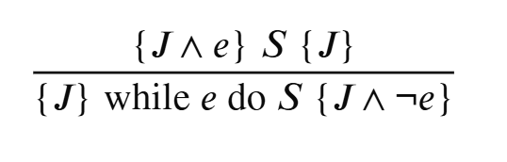
Hoare-logic rule
J ∧
(∀ x․ J ∧ e ⟹ wp⟦ S, J ⟧) ∧
(∀ x․ J ∧ ¬e ⟹ Q)

Slide 48
Translating calc
calc {
E0;
== { S0 }
E1;
< { S1 }
E2;
}
Source
S0
assert E0 == E1
S1
assert E1 < E2
assume E0 < E2
IVL

Slide 49
Translating calc
calc {
E0;
== { S0 }
E1;
< { S1 }
E2;
}
Source
S0
assert E0 == E1
assume false
[]
S1
assert E1 < E2
assume false
[]
assume E0 < E2
IVL

Slide 50
Translating calc
calc {
E0;
== { S0 }
E1;
< { S1 }
E2;
}
Source
S0; assert wf⟦ E0 ⟧; assert wf⟦ E1 ⟧
assert E0 == E1
assume false
[]
S1; assert wf⟦ E2 ⟧
assert E1 < E2
assume false
[]
assume E0 < E2
IVL

Slide 51
Translating calc
calc {
E0;
== { S0 }
E1;
< { S1 }
E2;
}
Source
S0; assert wf⟦ E0 ⟧; assert wf⟦ E1 ⟧
assert E0 == E1
assume false
[]
S1; assume wf⟦ E1 ⟧; assert wf⟦ E2 ⟧
assert E1 < E2
assume false
[]
assume wf⟦ E0 ⟧ ∧ wf⟦ E2 ⟧ ∧ E0 < E2
IVL

Slide 52
Some references
(the first 3 describe good ways to compute wp, the last shows the entire 2008 translation from Dafny to Boogie)
Avoiding exponential explosion: generating compact verification conditions
Cormac Flanagan and James B. Saxe.
POPL 2001: 193-205.
Efficient weakest preconditions
K. Rustan M. Leino
Information Processing Letters, 93(6), 2005.
https://leino.science/papers/krml114.pdf
Weakest-Precondition of Unstructured Programs
Mike Barnett and K. Rustan M. Leino.
PASTE 2005.
https://leino.science/papers/krml157.pdf
Specification and verification of object-oriented software
K. Rustan M. Leino.
Marktoberdorf International Summer School 2008, lecture notes.
https://leino.science/papers/krml190.pdf

Slide 53
Logic engine
Satisfiability modulo theories (SMT) solver
Saturation-based first-order prover
AI

Slide 54
Reflections on language design
Lecture 3

Slide 55
Learning from trying to verify Java and C#
Strings

Slide 56
String concatenation in Java
String concat(String s, String t)
{
return s + t;
}

Slide 57
Pure methods
@Pure
String concat(String s, String t)
{
return s + t;
}
assert concat(a, b) == concat(a, b);

Slide 58
Learning from trying to verify Java and C#
Strings and other immutable types should not be references
  Include non-reference types in the language
“Pure” methods are hard to make pure enough (that is, too few methods are actually pure)
  Provide functions
Equals methods are the result of a too-OO mindset
  Use references if you need mutation or identity
  Otherwise, use datatypes
Don’t give access to this until it’s really constructed
  Use 2-phase constructors
It takes effort to prove the absence of arithmetic overflows
  Provide easy access to unbounded integers (even the default?)

Slide 59
Syntax
function
ghost function

Slide 60
Specifications
Sometimes, loops are overly specific

Slide 61
Initialize a matrix
method Init<X>(arr: array2<X>, x: X)
modifies arr
ensures forall i, j :: 0 <= i < arr.Length0 &&
0 <= j < arr.Length1 ==>
arr[i, j] == x
{
var m := 0;
while m < arr.Length0
invariant 0 <= m <= arr.Length0
invariant forall a, b ::
0 <= a < m && 0 <= b < arr.Length1 ==> arr[a, b] == x
{
var n := 0;
while n < arr.Length1
invariant 0 <= n <= arr.Length1
invariant forall a, b ::
0 <= a < m && 0 <= b < arr.Length1 ==> arr[a, b] == x
invariant forall b :: 0 <= b < n ==> arr[m, b] == x
{
arr[m, n] := x;
n := n + 1;
}
m := m + 1;
}
}

Slide 62
Aggregate statement (forall statement)
method Init<X>(arr: array2<X>, x: X)
modifies arr
ensures forall i, j :: 0 <= i < arr.Length0 &&
0 <= j < arr.Length1 ==>
arr[i, j] == x
{
forall i, j | 0 <= i < arr.Length0 && 0 <= j < arr.Length1
{
arr[i, j] := x;
}
}

Slide 63
Specifications
Sometimes, loops are overly specific
  Add aggregate statements
Some loops are difficult to specify

Slide 64
Remove the minimum of binary search tree
8
4
12
2
6
10
14
1
3
5
7
9
11
13
15
The minimum is the leftmost node: follow left children from the root, 8 → 4 → 2 → 1.

Slide 65
Code for removing minimum
class Node {
var value: int
var parent: Node
var left: Node?
var right: Node?
ghost var Descendants: set<Node>
}
Remove(root: Node) {
var p := root
while p.left != null {
p := p.left
}
p.parent.left := null
// update all the Descendants
return p
}
RecursiveRemove(root: Node) {
if p.left == null {
p.parent.left := null
return p
}
var r := RecursiveRemove(p.left)
p.Descendants := p.Descendants – {r}
return r
}
*) specifications and various edge cases omitted

Slide 66
Specifications
Sometimes, loops are overly specific
  Add aggregate statements
Some loops are difficult to specify
  Offer tail-recursive compilation, modulo ghosts
Having to rewrite functions with accumulators to make them tail recursive is cumbersome
  Offer auto-accumulator tail recursion
User-defined well-founded orders are difficult to verify correct
  Provide a fixed well-founded order for all types

Slide 67
Framing
Dafny supports specifying and verifying mutable data structures in the heap by
  Including modifies and reads clauses
  Including sets
  Including ghosts

Slide 68
Conclusion
Program proofs are becoming more accessible
Become familiar with proving programs!
Teach!
Program safely!

